Slide 1
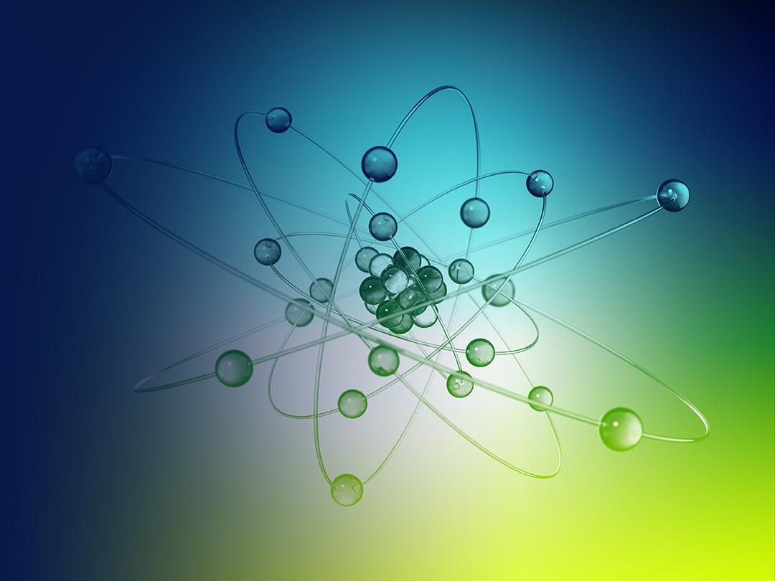


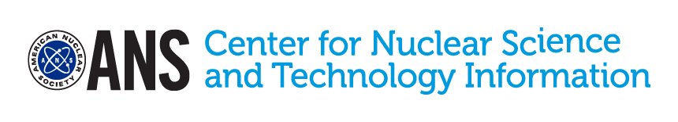
NUCLEAR ENERGY

Slide 2
Nuclear Power:
Fact or Misconception?
Claim 1: A nuclear reactor can explode
like a nuclear bomb.
Claim 2: Nuclear energy is bad for the environment.
Claim 3: Nuclear power releases dangerous amounts of radiation into the atmosphere.
Claim 4: Nuclear power plants are some
of the safest and most secure workplace
facilities in the U.S.

Slide 3
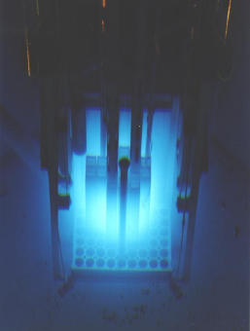
Lesson Objectives
You will:
Model the natural physical process of nuclear fission.
Evaluate the benefits and risks of nuclear
power, especially in comparison to other
power sources.
Analyze and communicate the science
behind uses of nuclear power.

Slide 4
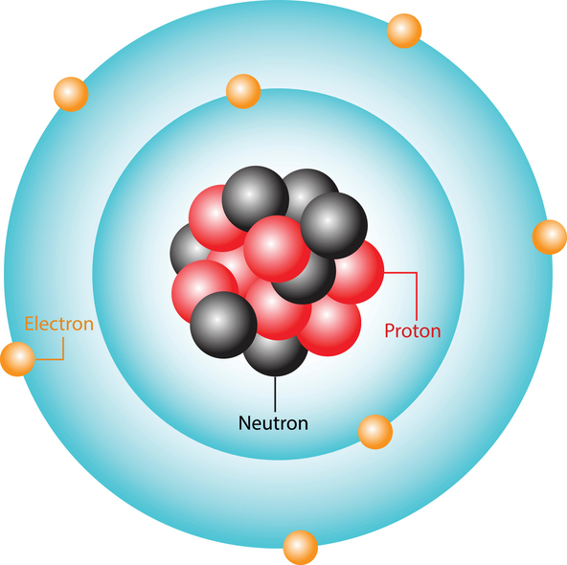
Background
Atoms make up all matter, and they are made
up of three smaller particles.
The atom’s nucleus contains two of the small particles, known as neutrons and protons.
Each element can have different numbers
of neutrons, but always the same number of protons. Elements with different numbers
of neutrons are called isotopes.
Nucleus

Slide 5

Boiling Water Reactor
What do you think is happening in this animation?
What do you predict is the purpose of a boiling water reactor?
Can you explain where you have seen or heard the words turbine or generator before?

Slide 6
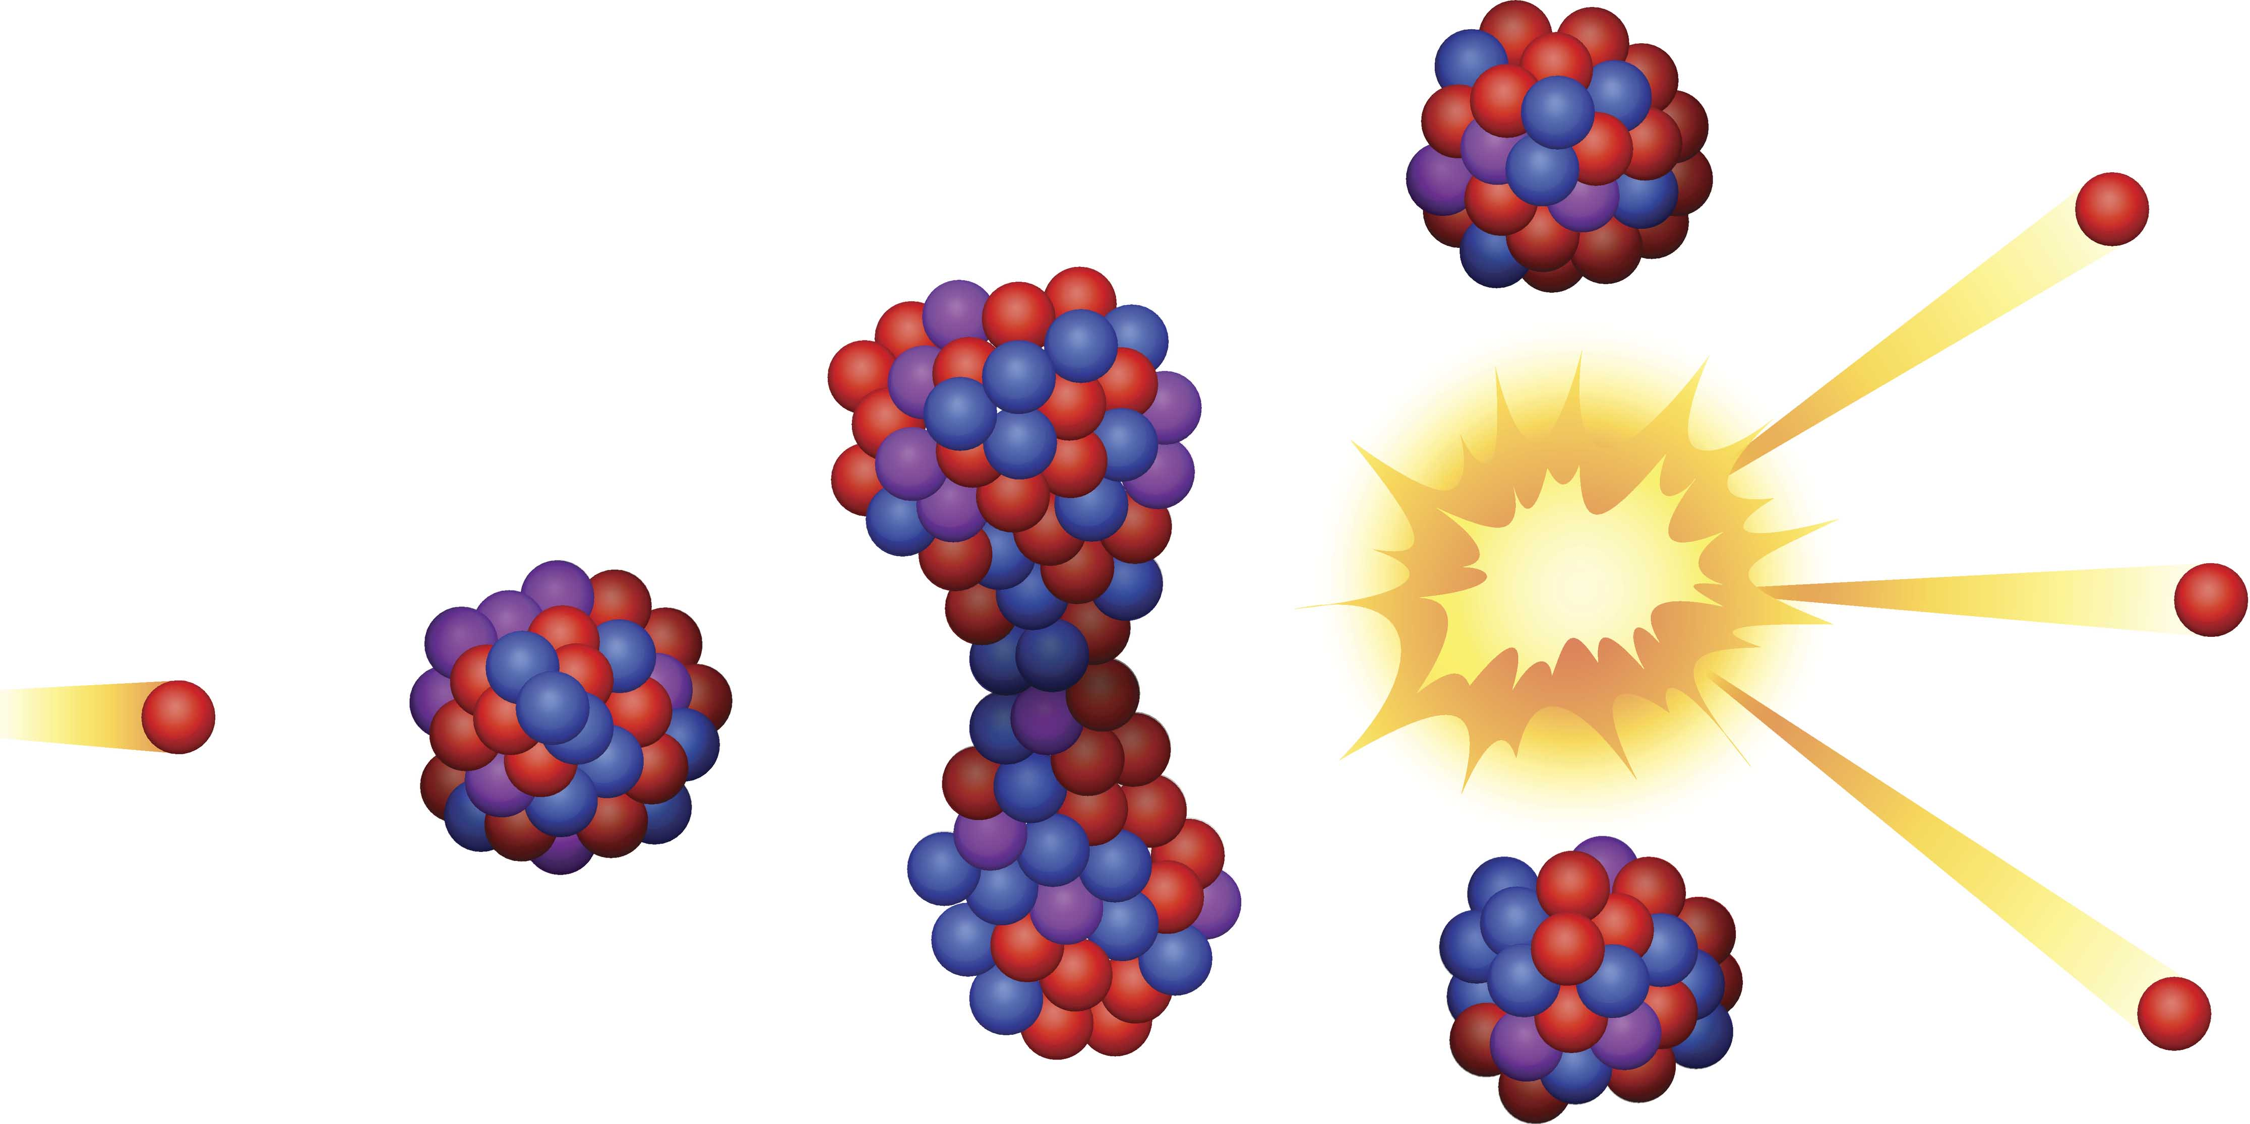
Nuclear Fission
The nucleus vibrates and splits.
A neutron strikes the nucleus of a heavy and unstable isotope.
A nucleus being split results in fission.
Heat energy is produced.
The nucleus becomes unstable.

Slide 7
Boiling Water Reactor
Where in the nuclear reactor is fission occurring?
What is the water being used for?

Slide 8
Oklo, the two Billion Year Old Nuclear Reactor!
Click to view video

Slide 9
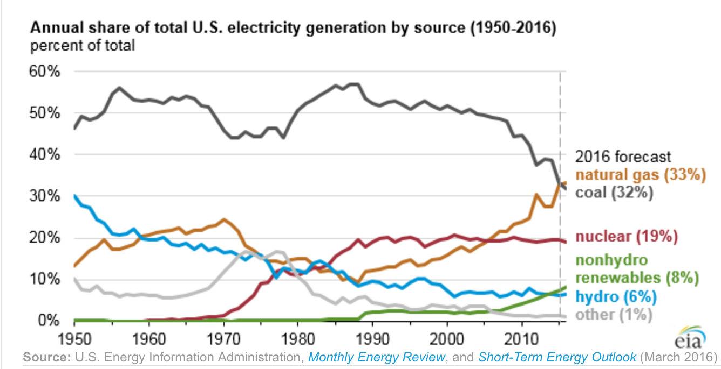
Historical Use of Nuclear
Power Data

Slide 10
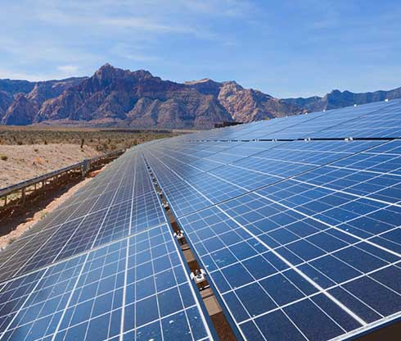
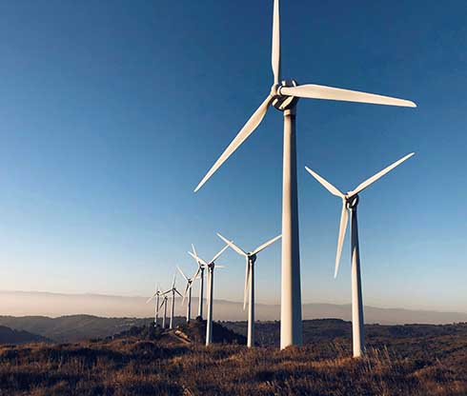
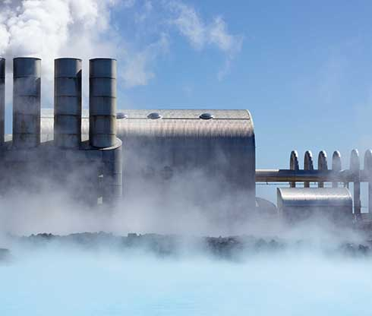
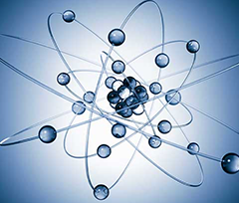
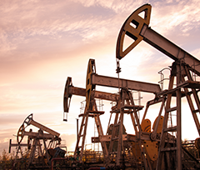
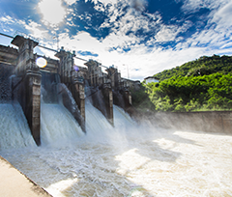
What Powers our World?

Slide 11
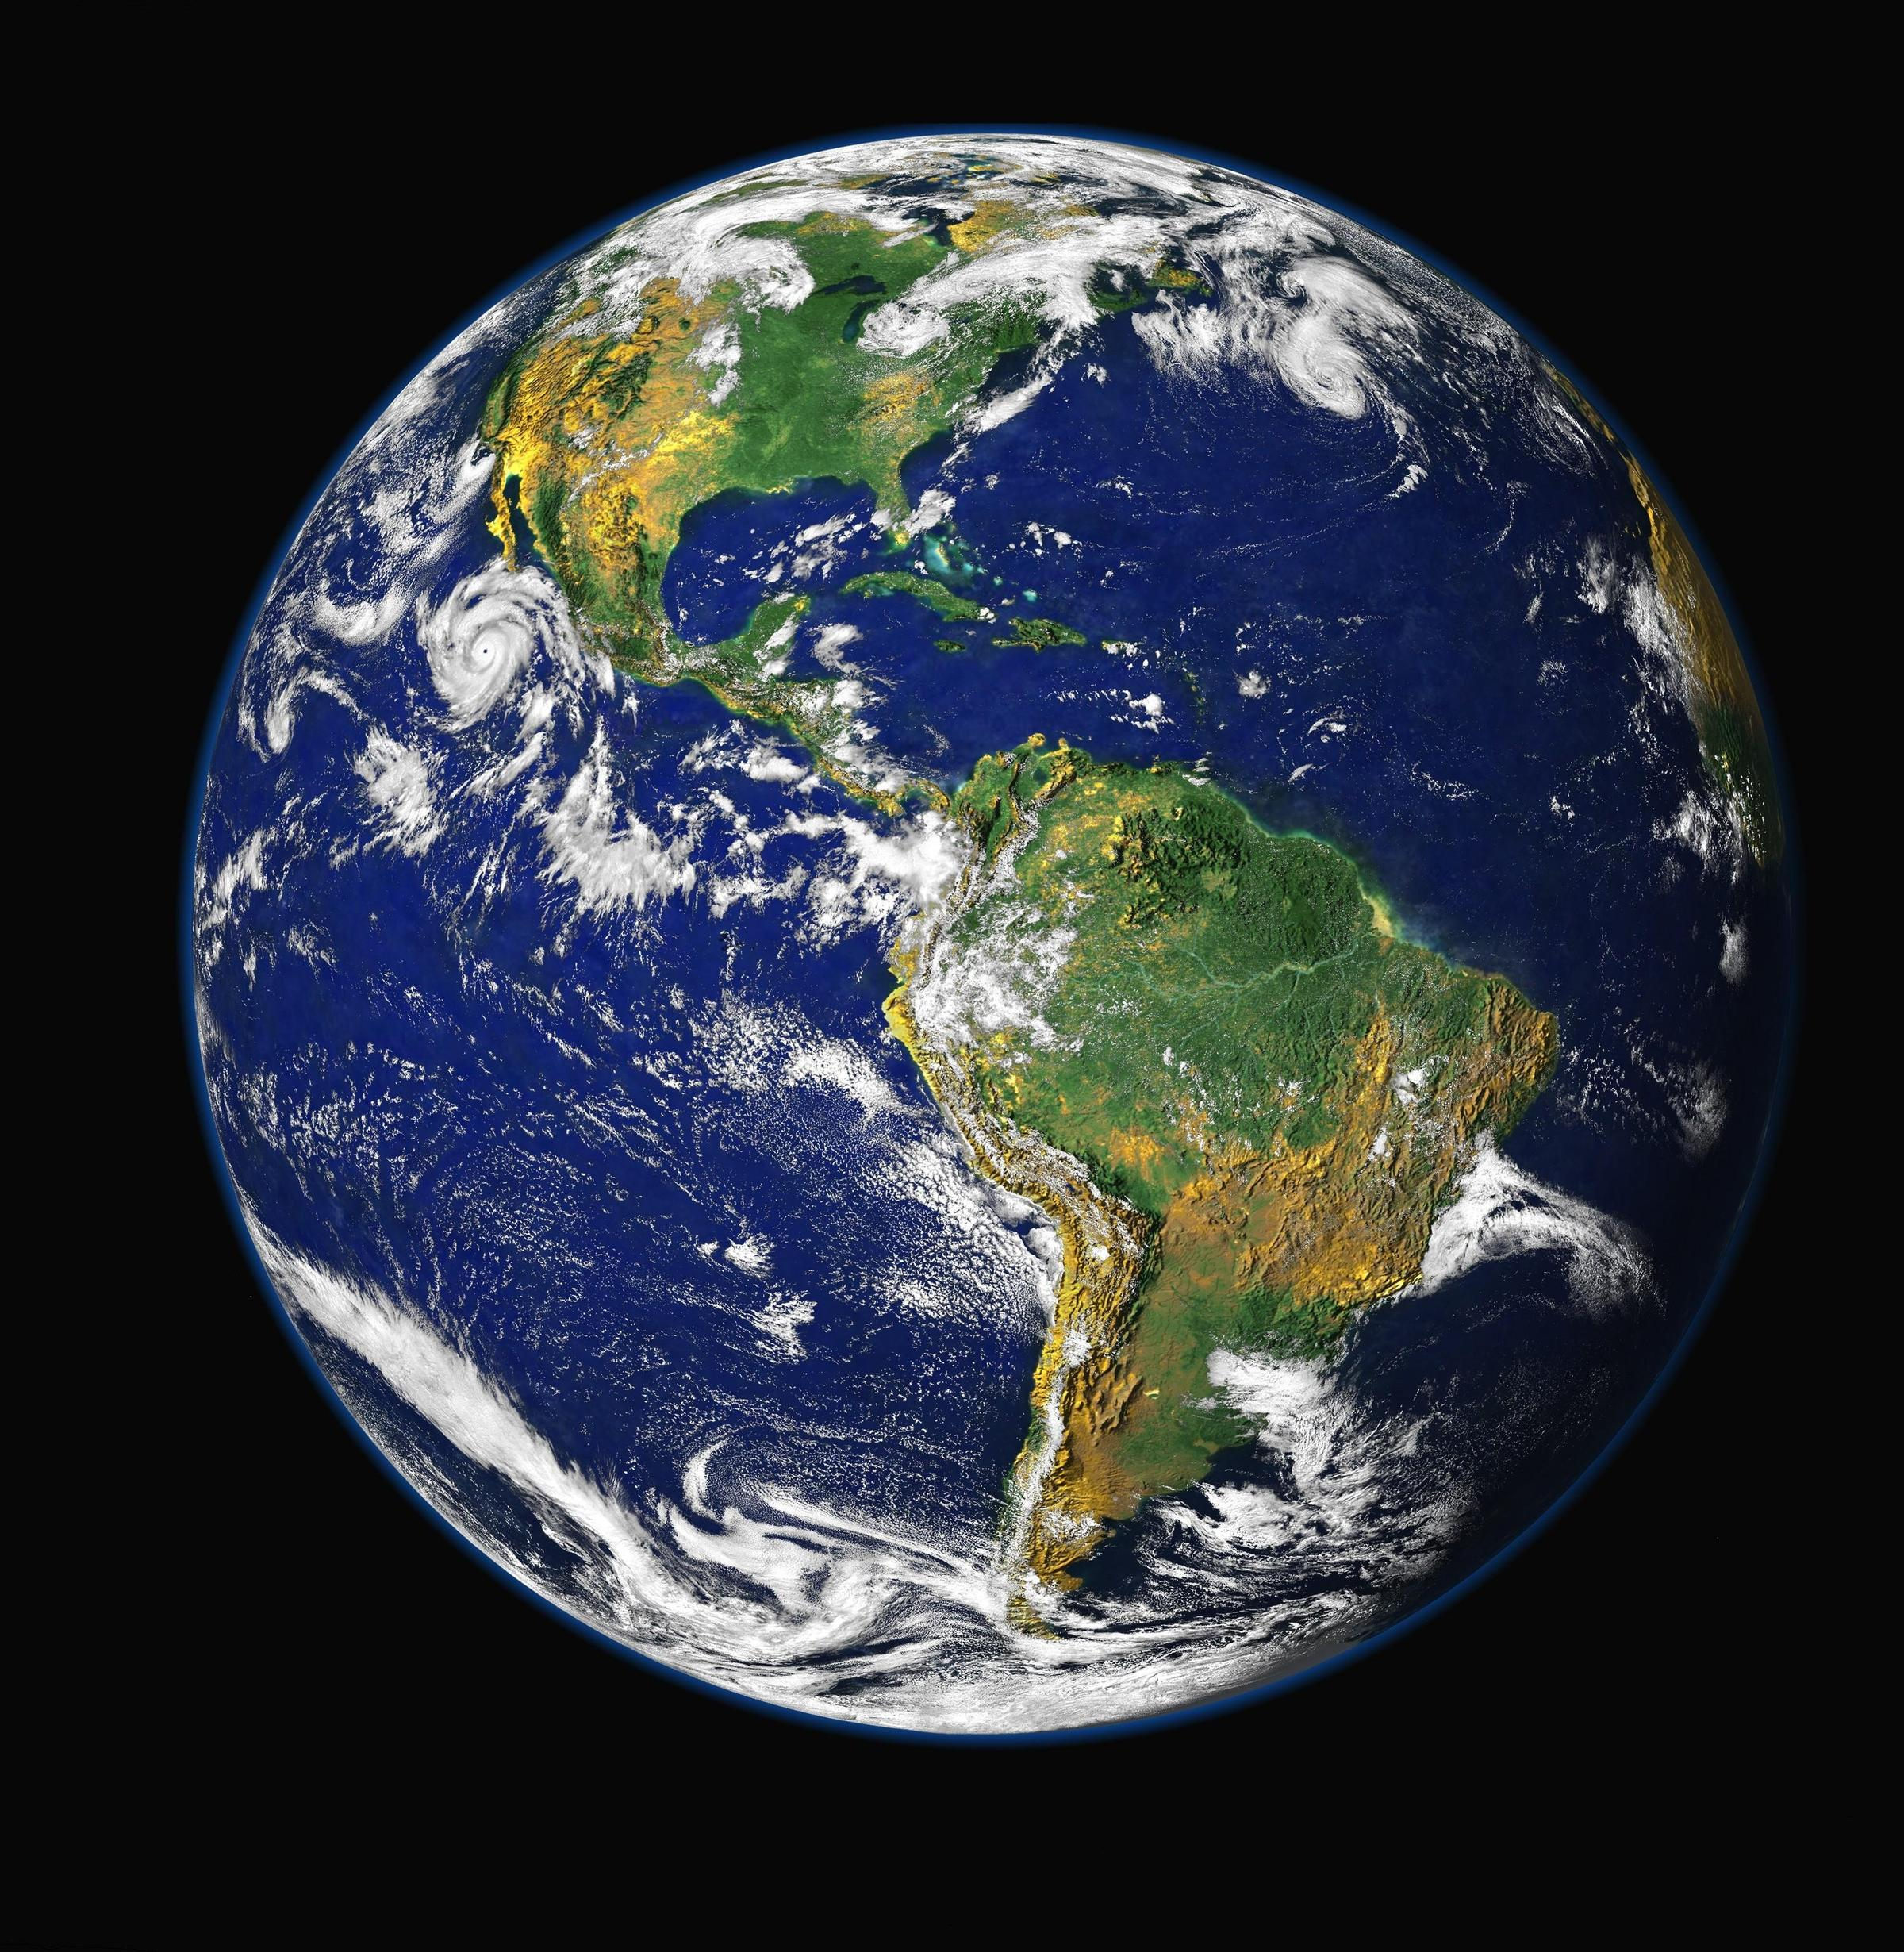
Benefits of Nuclear Power
No carbon emissions: The primary benefit of nuclear power over fossil fuel power is that it is a low-emission power source
Low fuel costs: The uranium fuel for a nuclear reactor costs roughly 20% of the cost of energy generated.
Stable power source: Unlike renewable energy sources like solar and wind, nuclear provides continuous, reliable power.
Safety: Considering the effects of mining, drilling, and pollution, nuclear power is safer than fossil fuel power plants.

Slide 12
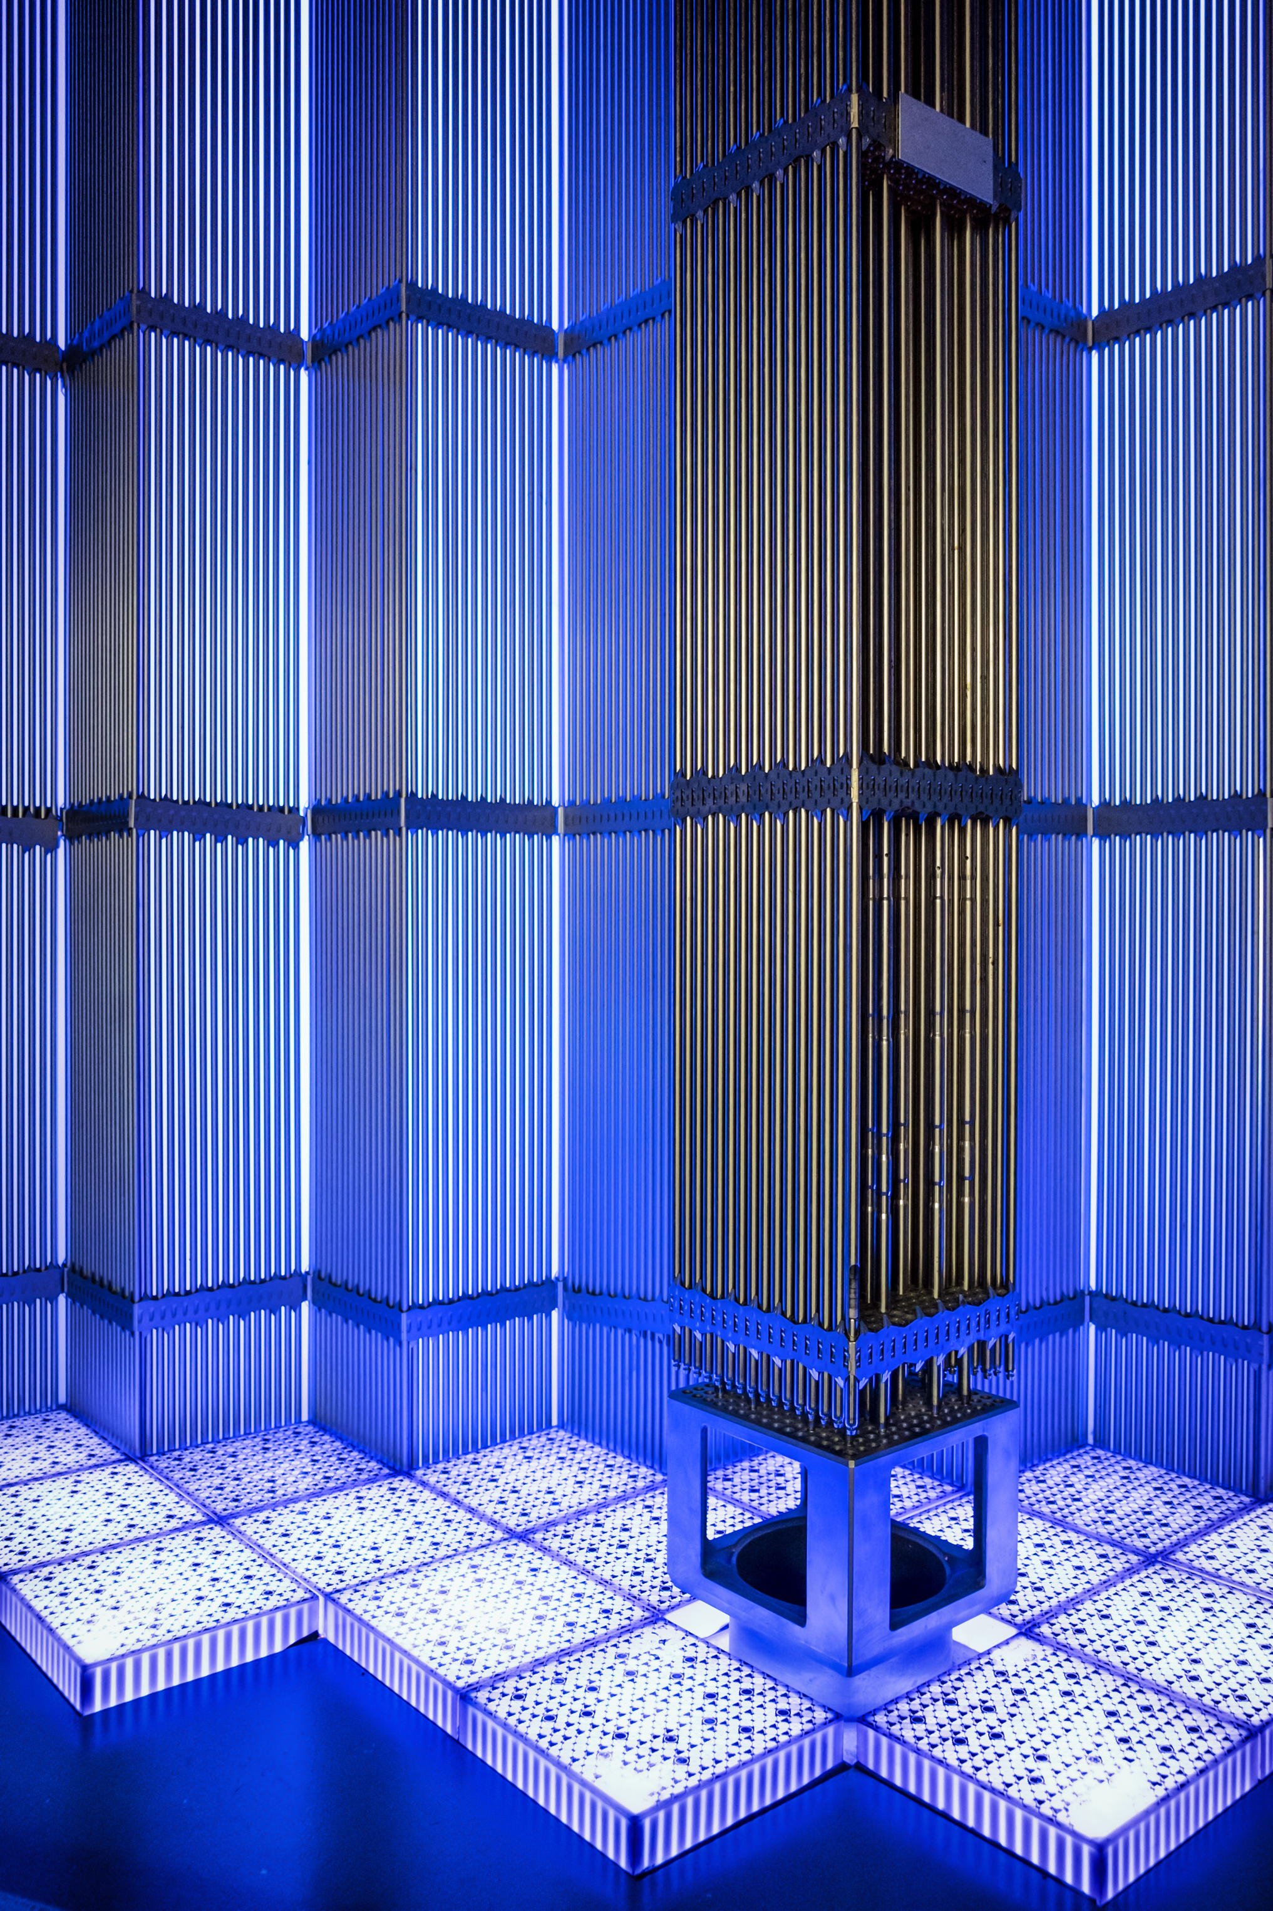
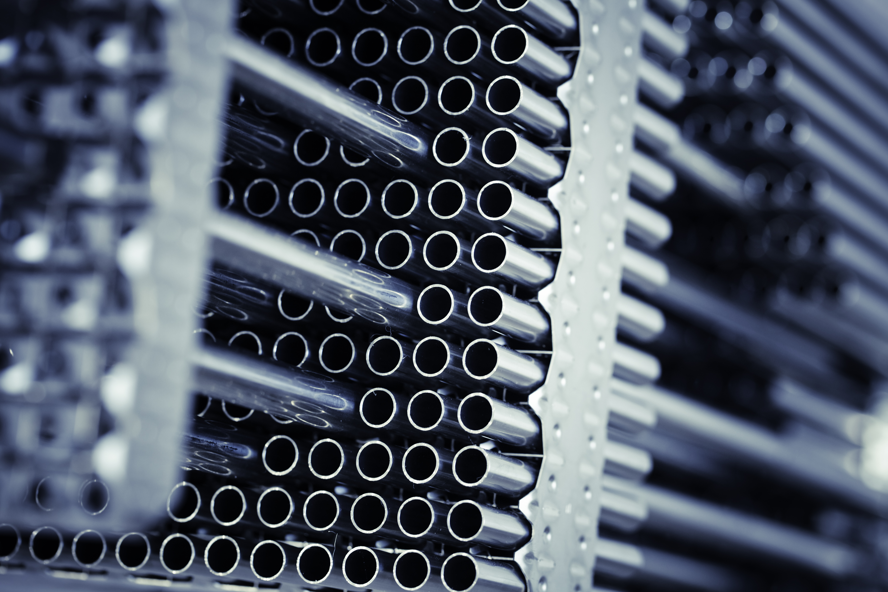
Engineering the Future
Up close image of the fuel rods
How a bundle of fuel rods fits into the reactor
Notes:
Talking Points for fuel rods:
A nuclear reactor in its simplest form involves uranium, control rods, and water encased in a concrete and steel containment vessel.
The uranium provides the fissile material (the atoms that split). It releases neutrons when it is split, and these neutrons then make other uranium atoms split.
The control rods absorb excess neutrons and control the speed of the reaction.
The water slows down the neutrons: without the water, the reaction will not happen. It also absorbs the heat of the reaction and turns into steam. The steam leaves the vessel and is used to generate electricity.

Slide 13
Summary
Nuclear power consists of nuclear reactions that generate heat.
Many stated risks of nuclear energy will be inaccurate, including the explosive potential, radiation release, and the hazards to people near the nuclear reactors.
The biggest benefits of nuclear power include that it is a low-emission energy source, the fuel is cheap, and that it is safer than other power sources such as fossil fuel plants.
Nuclear power generally generates electricity by heating water into steam that turns a turbine attached to a generator, which generates the electricity.

Slide 14
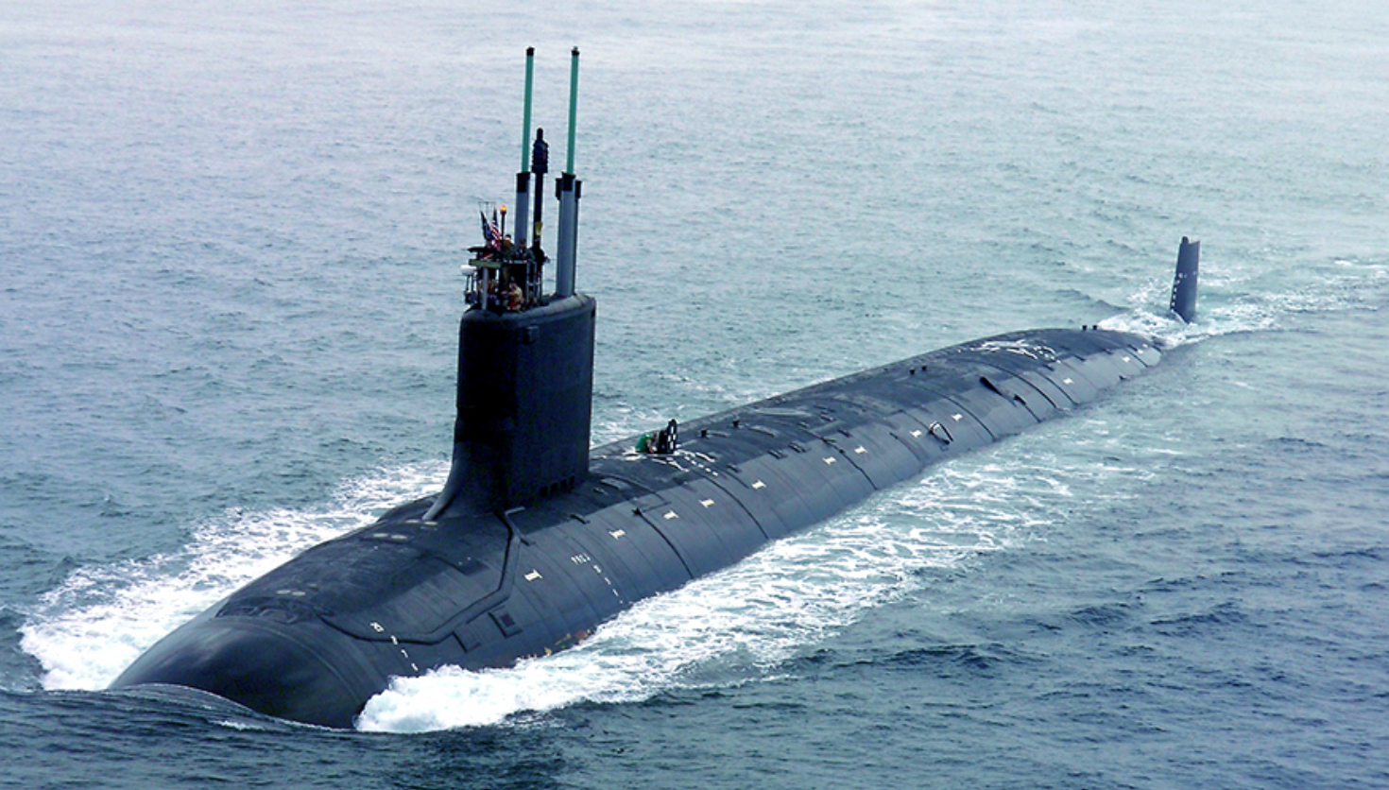
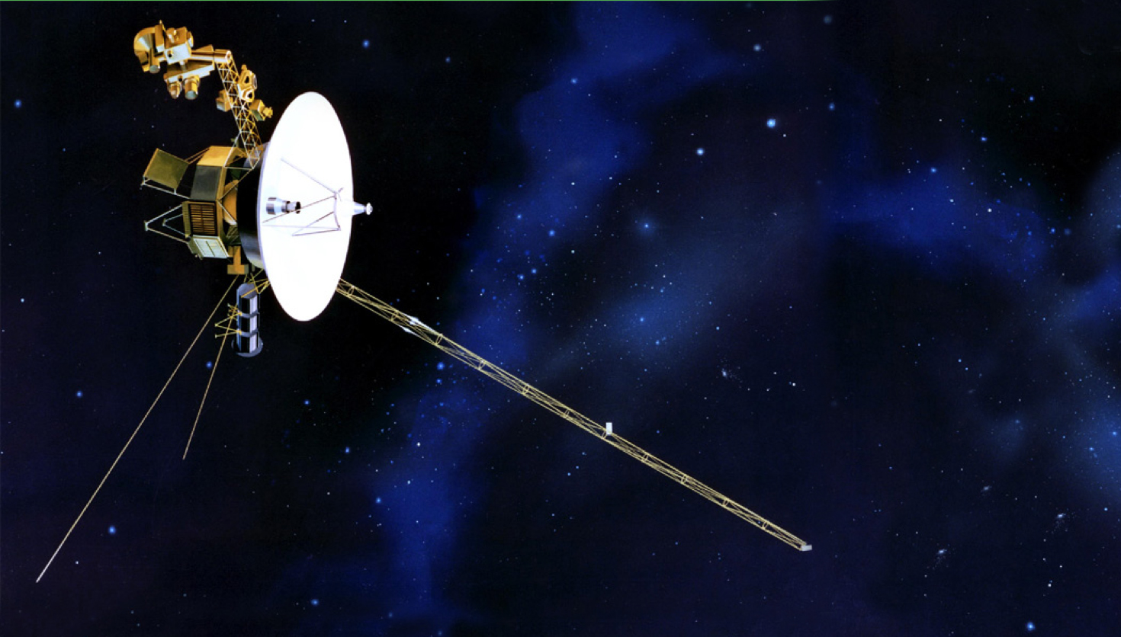
Using Nuclear to Generate Electricity

