Slide 1
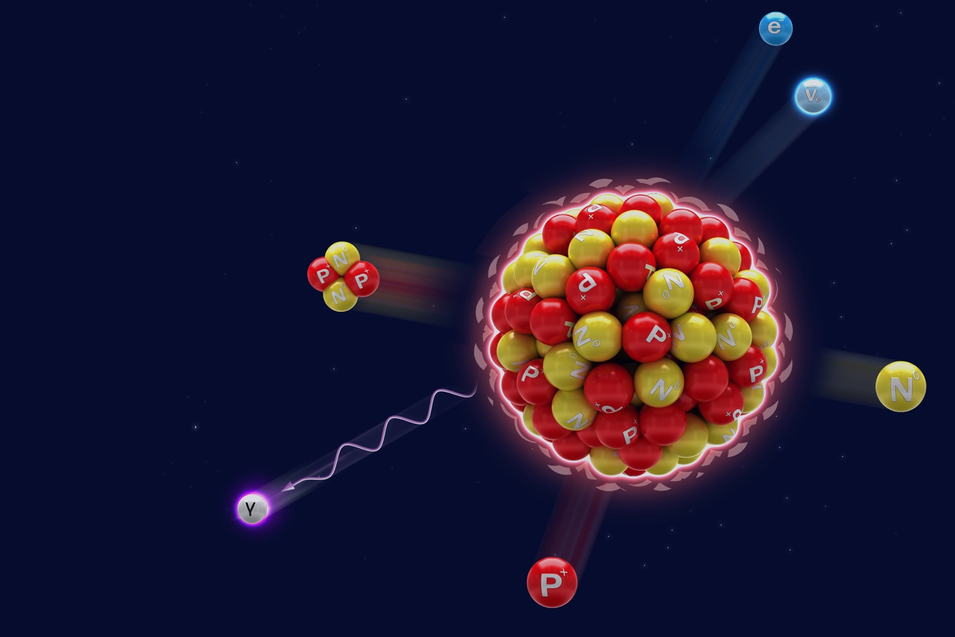




REALITIES OF RADIATION

Slide 2

MythBustin’:
Realities of Radiation
ENGAGE
Myth #1:
You are naturally radioactive.
CONFIRMED
OR BUSTED?!?
You decide!
Notes:
Instructor Notes:
Open by asking students to pair up for an activity that will test their knowledge of the realities of radiation. Give each pair a copy of the “Myth-Bustin’: Realities of Radiation” CER Capture Sheet.
Introduce the three statements about radiation to which students must apply critical thinking and problem-solving skills in order to “Confirm” or “Bust.” Ask students to write the statement in the first column.
Have students make predictions about which statements they believe they will “Confirm” or “Bust.” Play the selected video clip for each statement:
"You are naturally radioactive."
https://www.epa.ie/radiation/radexp/exposure/
"Radiation is used to control mosquito populations and hinder disease.”
https://www.youtube.com/watch?v=RVMAasW5dHc&t=75s
“You are exposed to low levels of radiation when you fly.”
https://www.cdc.gov/nceh/radiation/air_travel.html

Slide 3
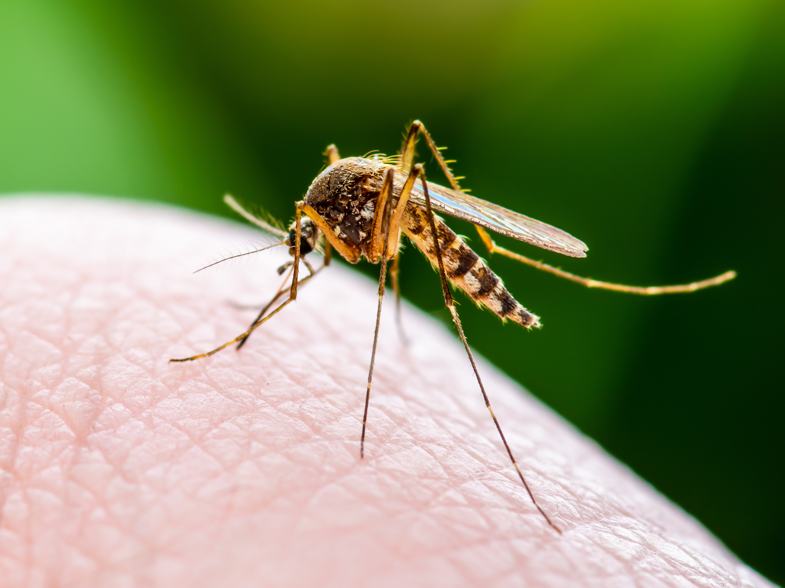
MythBustin’:
Realities of Radiation
ENGAGE
Myth #2:
Radiation is used to control mosquito populations and hinder disease.
CONFIRMED
OR BUSTED?!?
You decide!

Slide 4

MythBustin’:
Realities of Radiation
ENGAGE
Myth #3:
You are exposed to low levels of radiation when you fly.
CONFIRMED
OR BUSTED?!?
You decide!

Slide 5

Confirmed? Or Busted?
What evidence did you use to determine if each myth was confirmed or busted?
Vote CONFIRMED or BUSTED for each myth. Make sure you can support your answer with evidence!
What did you learn about radiation that you didn’t know before?
Do you think that radiation is something that people should fear?
Notes:
Instructor Notes:
As the students watch each clip, ask them to record and discuss evidence that would support their choice to “Confirm” or “Bust” each statement in the last column of their capture sheet.
To conclude, review the statements as a class and allow students to vote with “Confirmed” or “Busted.” Ask students to share the evidence they found to support their stance.
Key Talking Points:
What did you learn about radiation that you didn’t know before?
Do you think that radiation is something that people should fear?

Slide 6
How do these terms relate?
LEARN
In the next activity you will study the various types of radiation by conducting research.
Which of the terms in the image have you heard of before?
How do you think these terms relate to one another?
radio
beta
particle
low
Visible
radiation
light
infrared
electromagnetic
energy
alpha
microwaves
gamma
waves
high
ionizing
X-rays
rays
neutrons
Notes:
Instructor Notes:
Direct students’ attention to the word cloud of terms on the screen. Explain to students that before they can further study radiation and how it relates to their lives, they need to have an understanding of how all of these terms relate to one another.
As they have already learned, some types of radiation are harmless to us and some types can be very dangerous.
Key Talking Points:
Radiation is a broad term that includes many different types
Radiation can be divided into categories according to form and energy level

Slide 7
Radiation Concept Map
Each group should get a copy of the Radiation Concept Map Notes Sheet, a card set, string,
and scissors.
Your task is to organize and connect the terms (using string) to create a concept map that shows how the various types of radiation relate to one another.
You should begin by doing research and filling out
the notes sheet.
Sources to get you started:
Radiation Basics
https://www.nrc.gov/about-nrc/radiation/health-effects/radiation-basics.html
Introduction to the Electromagnetic Spectrum
https://science.nasa.gov/ems/01_intro
Notes:
Instructor Notes:
Ask students to get into pairs or small groups.
Explain to students that they will be given string, scissors, and set of cards that contain terms relating to radiation.
They should use their student devices and the internet websites provided in the powerpoint to research how these terms relate to each other and create a concept map.
To help them get started, point out that the red card with the term RADIATION should be the heading. Then, the two blue cards with the terms ELECTROMAGNETIC RADIATION and PARTICLE RADIATION should divide the rest of the cards into two major groups and connect the cards using the string.
Give each student group a copy of the RADIATION CONCEPT MAP NOTES SHEET. Explain that they can use this to take brief notes as they research how the cards relate to one another.
Once groups have finished their own sort, ask student groups to compare their card sort with another group and discuss how and why they sorted them in the way they did.
*TEACHER NOTE—Students may use free online concept mapping tools, such as www.creately.com to create a digital concept map in place of using cards. A tutorial to help students learn how to use Creately can be found here: https://www.youtube.com/watch?v=EfUhwl3Q91s and should be shown before students begin to create the concept map.
Key Talking Points:
Radiation can be determined by wavelength or particles emitted
Higher energy radiation removes electrons from atoms

Slide 8
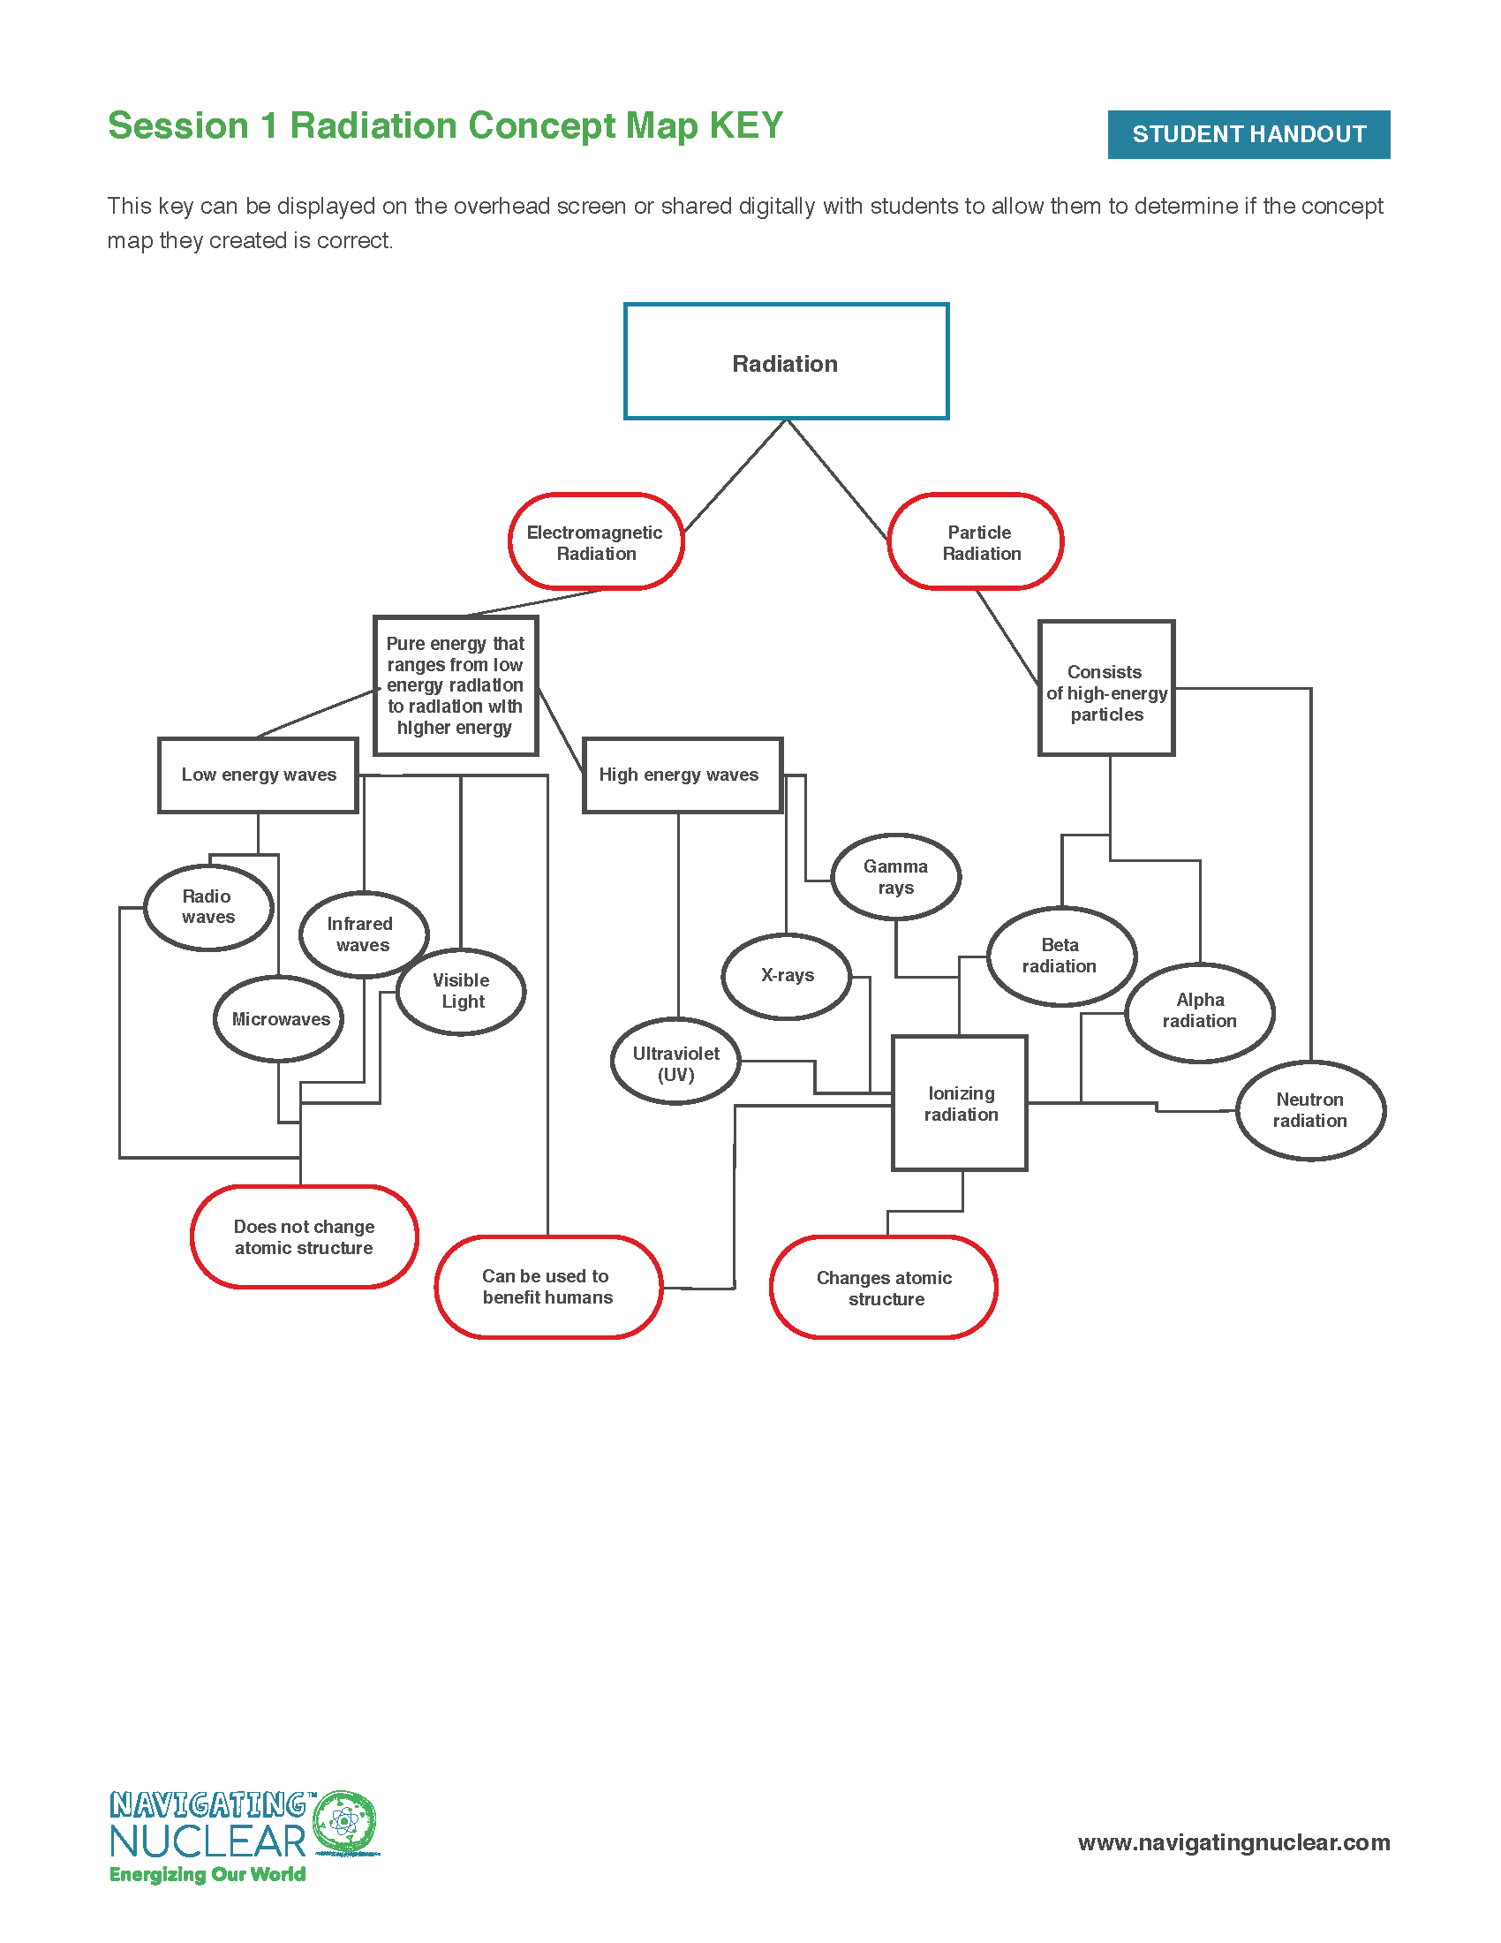
Radiation Concept Map: Key
How did you do on the concept map?
What makes the various types of radiation different from each other?
Would you add any other headings to this concept map to group the types of radiation?
Notes:
Instructor Notes:
Reveal the answers to the Radiation Concept Map on the overhead screen. Ask students to discuss any errors they had as they were sorting the cards to identify misconceptions or questions about radiation.
Ask students to copy down the concept map correctly on the back of their notes sheet.
Engage in a class discussion to end the lesson and activate brainstorming for session 2 of this lesson: What are the types of radiation that are potentially dangerous to living things? Why is this? What is different about these types of radiation (ionizing) that allows them to impact our health?
Key Talking Points:
How can creating a concept map help us connect terms?
What do the various types of radiation have in common? How are they different?

Slide 9
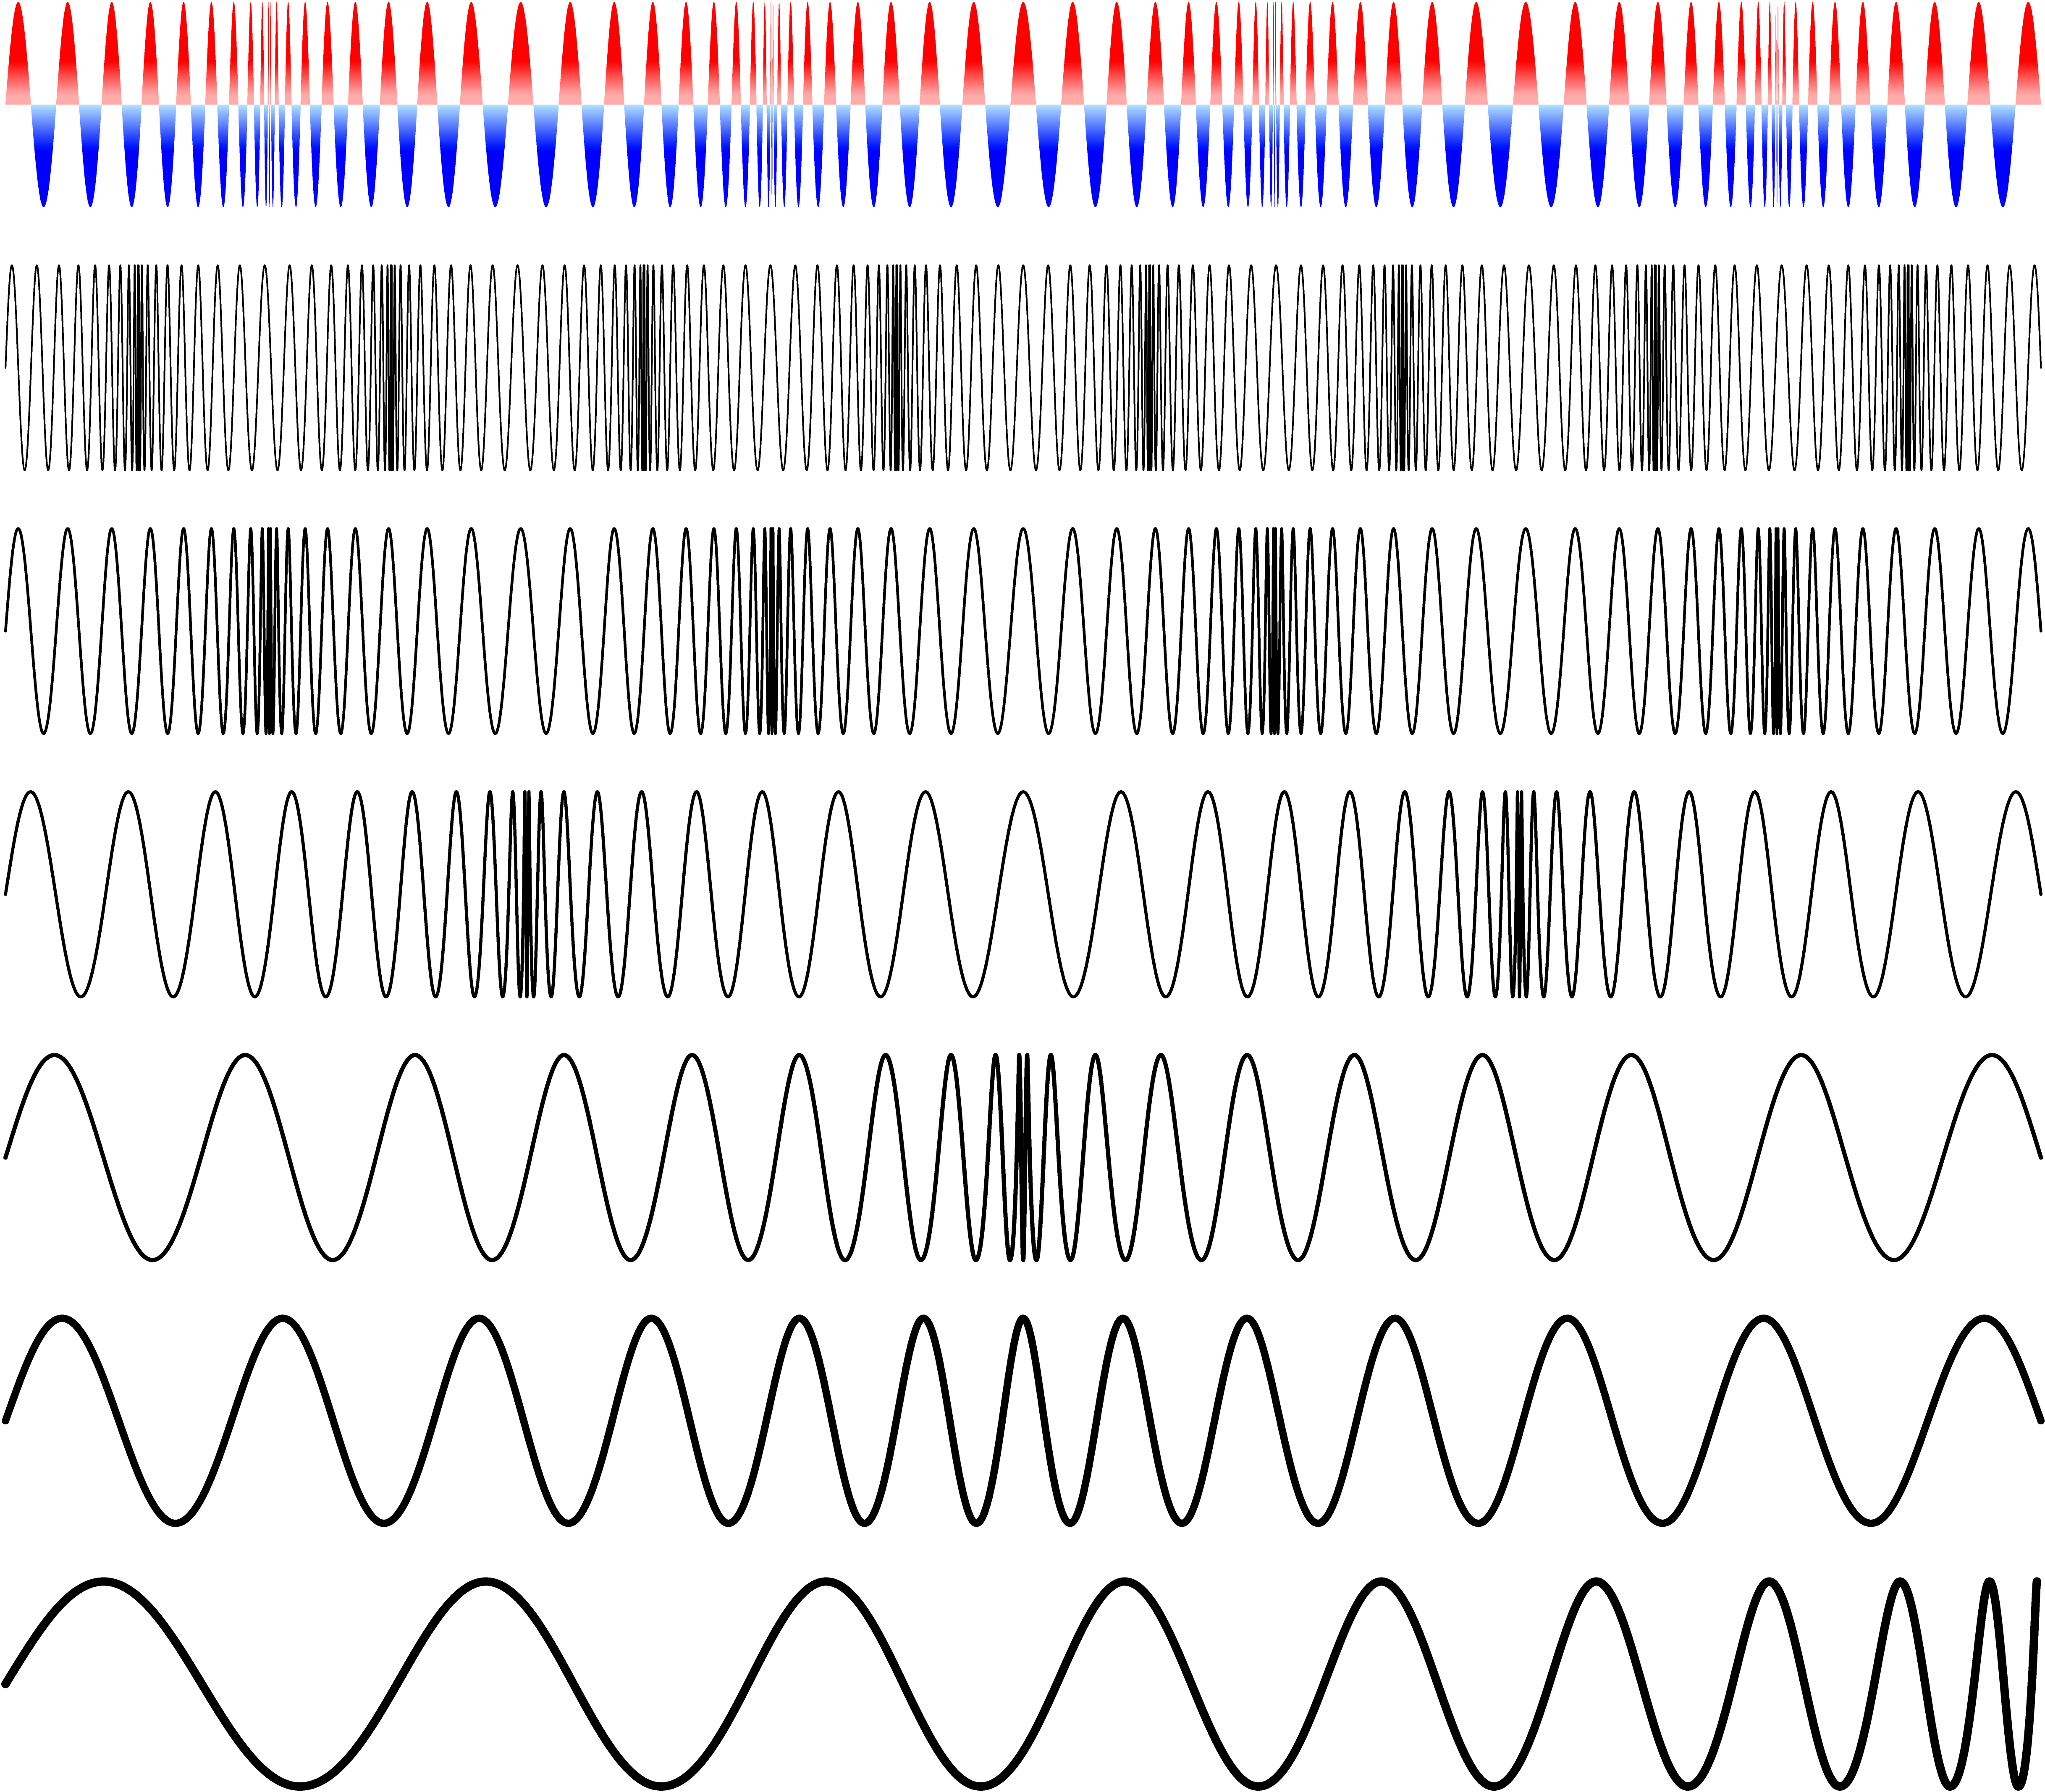
Session 1 Summary
Now that you have learned the basics about radiation, can you…
Define radiation.
Compare and contrast two major types of radiation: ionizing and non-ionizing.
Discuss how various types of radiation can affect human health.
Notes:
Instructor Notes:
Summary/Wrap of Session:
Determine if students can
-Define what “radiation” is
-Identify the two major types of radiation - wave and particle radiation.
-Determine how radiation may be harmful and how it can be beneficial

Slide 10
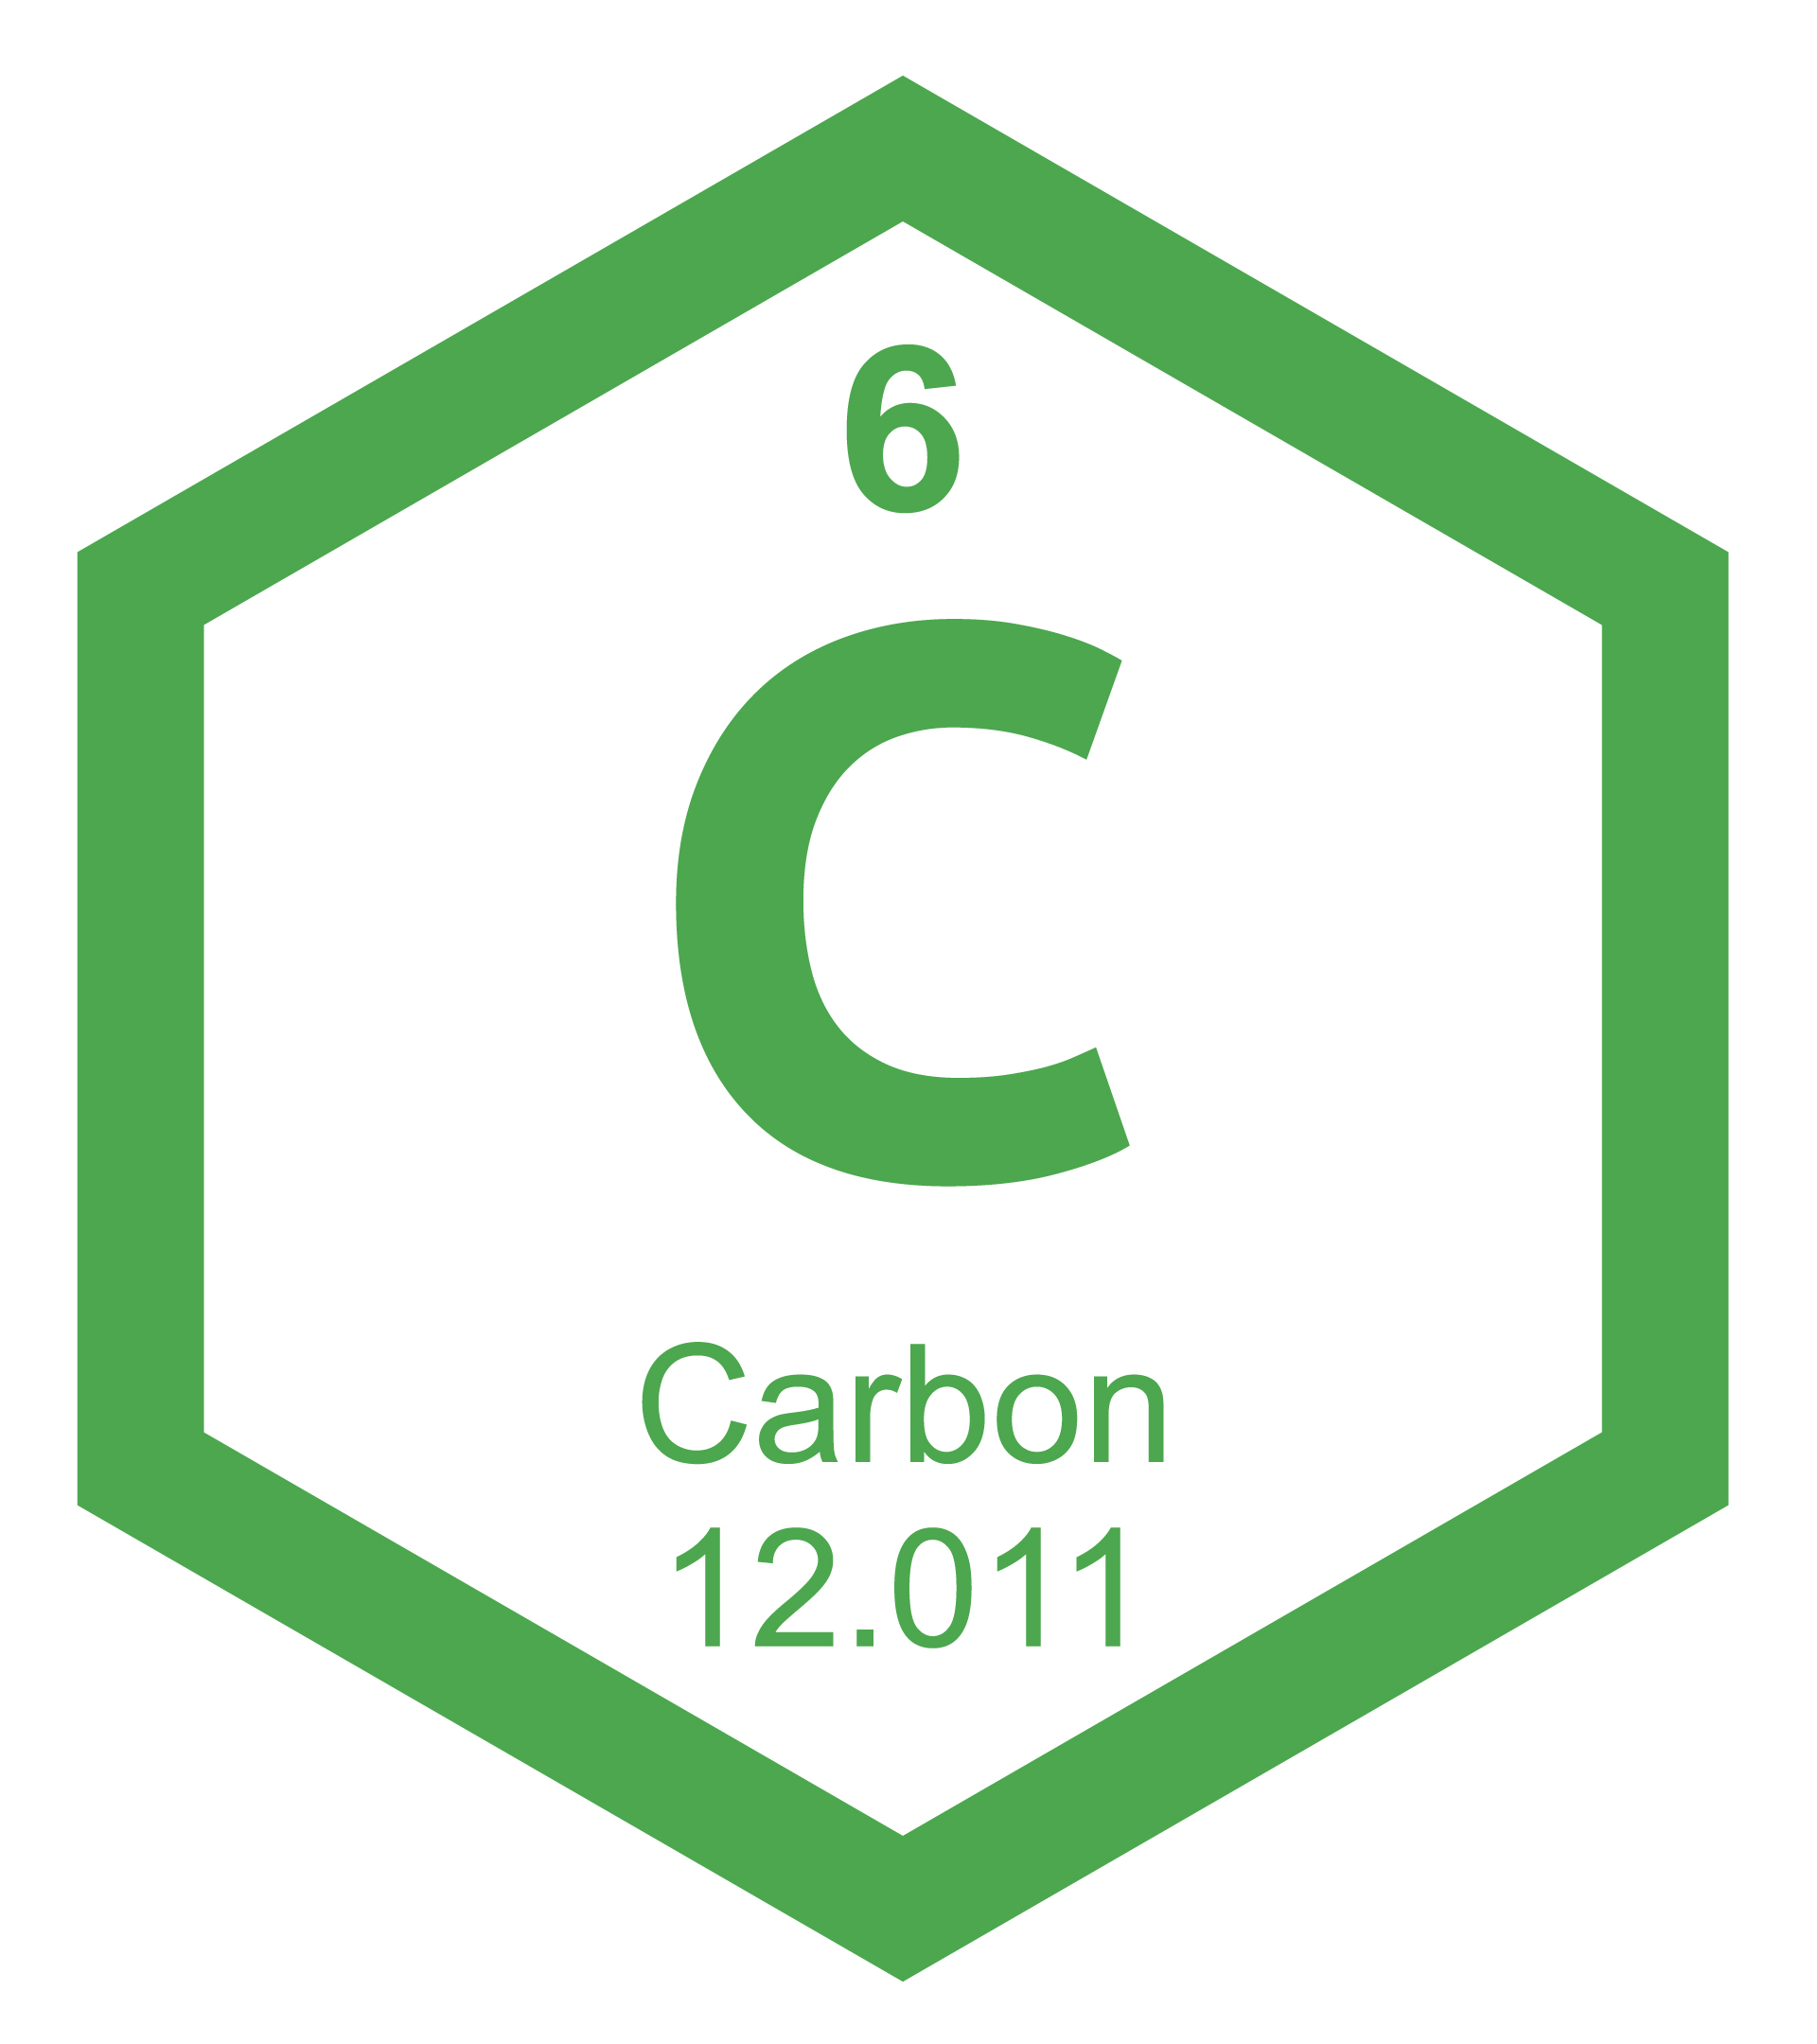
What is an atom and why does it emit radiation?
EXPLAIN
Now that you know the basics about radiation, let’s take a closer look at IONIZING RADIATION!
But let’s start with a quick review on atoms and the periodic table…
Can you identify the parts of an atom?
What does the periodic table tell us about carbon?
a
b
c
Notes:
Instructor Notes:
Explain to students that in order to understand where ionizing radiation comes from, they first need to review the basic structure of an atom and learn what causes a nucleus to become unstable.
Ask a student to volunteer to come up to the front and identify the parts of the model atom seen on Slide 9. Ask for feedback from the whole group to ensure that the student has correctly identified the parts of the atom, including the protons (A), neutrons (B), nucleus (A and B together), and electrons (C).
Next, ask for a second volunteer to explain the parts of the periodic table as seen in the image on Slide 9. They should be able to correctly identify the element name (carbon), atomic number (6), atomic symbol (C), and atomic weight (12.011). They should also understand that the atomic number is determined by the number of protons in the nucleus and that the atomic mass is the approximate number of protons and neutrons found in the atom (as electrons have nearly no mass). Students can also calculate the number of neutrons in an isotope by subtracting the atomic number from the mass number.
Key Talking Points:
Atoms are composed of protons, neutrons, and electrons
The number of protons defines the element
The nucleus is composed of protons and neutrons.
The mass of the atom is determined by the mass of the nucleus—the combined mass of the protons and neutrons.

Slide 11

Feeling a little unstable, atoms???
Each student should get a copy of the Radioactive Decay Notes Capture Sheet.
As you watch the video, fill in the notes sheet.
THINK:
What happens when the nucleus of an atom becomes unstable?
Why do atoms react differently?
Need more practice with atoms?
Virtually build atoms at: https://phet.colorado.edu/sims/html/build-an-atom/latest/build-an-atom_en.html
Notes:
Instructor Notes:
Hand out a copy of the Session 2 Radioactive Decay Notes Capture Sheet to each student.
Next, play the video. Ask students to answer the questions and complete the chart as they watch the video.
Key Talking Points:
There is a strong nuclear force holds the protons and neutrons of the nucleus of an atom together.
An unstable (radioactive) atom gives off excess protons or neutrons until it transforms into a stable atom.
The type of decay (alpha or beta) that occurs can change the atom into a different element and give off high energy radiation.
*If students need more practice with atoms, they can virtually build them by going to the following website on their devices: https://phet.colorado.edu/sims/html/build-an-atom/latest/build-an-atom_en.html

Slide 12
Balancing Nuclear Equations
Now it is time to complete PART 2 of your notes sheet.
The image shows alpha decay of the nucleus that results in the release of a helium nucleus.
The number on top represents the atomic mass of the alpha particle, and the number on bottom represents the atomic number.
Open the virtual periodic table on your laptop or iPad and go to https://ptable.com for a virtual periodic table.
Use this and your notes to help you balance the six nuclear equations!
Notes:
Instructor Notes:
Instruct students to take a look at the second part of their notes sheet where they will practice balancing nuclear equations.
Explain the diagram on the slide that shows that the top number in the equation represents the atomic mass and the bottom number represents the atomic number. Next, ask students to open the virtual periodic table on their devices (laptop or iPad) at https://ptable.com/ or give each student a paper copy of the periodic table.
You may want to complete the first problem as a class, giving students the correct answer after they have had a few minutes to complete it. (See solutions on the next slide) Then allow students time to balance the rest of the equations.
Allow students to compare their answers with the person(s) sitting next to them and discuss any differences between their answers.
Key Talking Points:
After decay, the type of atom may change according to the number of protons or neutrons in the nucleus.
Atoms that change the number of protons they have, will become a different element
Atoms that undergo alpha decay will change in their atomic mass, while atoms that undergo beta decay do not.

Slide 13
Balancing Nuclear Equations!
How many answers did you get correct?
Alpha Decay
²²⁴₈₈Ra → ²²⁰₈₆Rn + ⁴₂He
²³⁸₉₂U → ²³⁴₉₀Th + ⁴₂He
²¹⁰₈₄Po → ²⁰⁶₈₂Pb + ⁴₂He
¹⁴₆C → ¹⁴₇N + ⁰₋₁e
²³⁴₉₀Th → ²³⁴₉₁Pa + ⁰₋₁e
²¹⁰₈₂Pb → ²¹⁰₈₃Bi + ⁰₋₁e
Beta Decay
Notes:
Instructor Notes:
Once students have completed balancing the nuclear equations, reveal the answers to each problem on Slide 12. Ask for feedback from the whole group—how did they do?
Explain to students that to conclude this lesson, they will participate in a small group activity where they will calculate the half-life of a fictional isotope, which is the time it takes for half of the radioactive nuclei to decay and emit alpha, beta, or gamma radiation.
Key Talking Points:
Balancing nuclear equations can show us how atoms will change and what type of radiation will be emitted if they become unstable.

Slide 14
Determining the half-life of a fictional radioactive isotope
ACTIVITY
1 cup
50 pennies
50 dimes
A copy of the “Determining the Half-Life of a Radioactive Isotope Data” sheet
Read through the instructions on the sheet and record your data in the data table.
You should construct a graph when you are finished and follow the instructions to determine and indicate the half-life of their penny atoms on the graph.
For this activity you will need to form small groups of 3.
Each group needs the following materials:
Notes:
Instructor Notes:
Instruct students to form small groups of 3. Ask each group to get the following materials: 1 cup, 50 pennies, 50 dimes, and a copy of the “Determining the Half-Life of a Radioactive Isotope Data” capture sheet.
Ask students to read through the instructions on the sheet and record their data in the data table. They should construct the graph when they are finished and follow the instructions to determine and indicate the half-life of their penny atoms on the graph.
Ask each group to share what they determined the half-life of their penny atom is. How do the groups compare?

Slide 15
So how can we use the half-lives of elements?
In the next session, you will be looking at other ways that radiation can be used to help improve the lives of people or solve global problems!
Notes:
Instructor Notes:
So how can we use the half-lives of elements? Show students the following video clips on Slide 14.
How Does Radiocarbon Dating Work? https://youtu.be/phZeE7Att_s
How Does A Pet Scan Work? https://www.youtube.com/watch?v=GHLBcCv4rqk
Tell students that in the next session, they will be looking at other ways that radiation can be used to help improve the lives of people or solve global problems.
Key Talking Points:
We can help determine the relative age of fossils and geological formations by looking at the half-lives of substances like Carbon 14.
Radioactive tracers can be used in the medical field to help indicate harmful conditions such as tumors by giving off radiation as they decay.

Slide 16
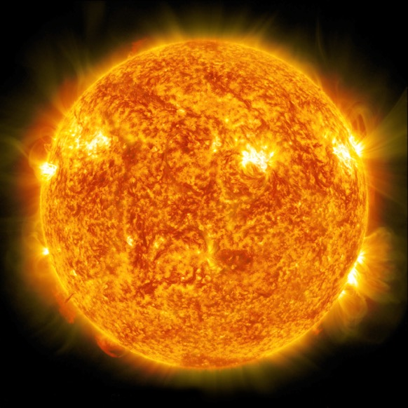
Session 2 Summary
Reflect on the importance of understanding ionizing radiation:
Remember:
What information have we gained from determining the half-lives of radioactive isotopes?
How can this knowledge guide us in using radiation?
Ionizing radiation may seem concerning at first glance but understanding this high-energy radiation has led to the discovery and creation of many techniques and tools that we use and depend on.
Notes:
Instructor Notes:
Ask students to reflect on the importance of understanding ionizing radiation. What information have we gained from determining the half-lives of radioactive isotopes? How can this knowledge guide us in using radiation?
Key Talking Points:
Ionizing radiation may seem dangerous at first glance, but understanding this high-energy radiation has led to the discovery and creation of many techniques and tools that we use and depend on.

Slide 17

Using Radiation for Good:
Radiation Innovations
CHALLENGE
GOAL: To research and brainstorm ways to improve how ionizing radiation and nuclear techniques are used to help solve global problems.
Get with a partner or small group.
Research area in which ionizing radiation is used.
Create an innovative and unique product (or a product that improves on one that already exists) that uses radiation to help to solve a problem.
Present a prototype model and explain how this product will theoretically work or improve an existing product!
Notes:
Instructor Notes:
Instruct students to form small groups of 3. Ask each group to get the following materials: 1 cup, 50 pennies, 50 dimes, and a copy of the “Determining the Half-Life of a Radioactive Isotope Data” capture sheet.
Ask students to read through the instructions on the sheet and record their data in the data table. They should construct the graph when they are finished and follow the instructions to determine and indicate the half-life of their penny atoms on the graph.
Ask each group to share what they determined the half-life of their penny atom is. How do the groups compare?

Slide 18
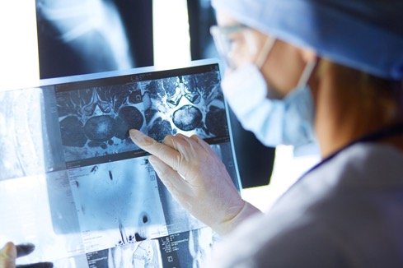

Examples of fields that use the power of radiation
Agriculture—Food irradiation
Agriculture—Crop pest sterilization
(SIT—Sterile Insect Technique)
Agriculture—Using nuclear science to trace nitrogen
in soil and crops
Medical—Radiation therapy for cancer
Medical—Radiation in x-rays and scans
Medical—Radiopharmaceuticals
Global Health—Mosquito sterilization
(SIT—Sterile Insect Technique)
Genetics—Gamma irradiation to improve and create
plant species
Environmental Science—Using nuclear science to trace microplastics in ocean life
Environmental Science—Using nuclear science to understand drought
Notes:
Instructor Notes:
Display the following areas in which radiation is used and examples of how it is used:
Agriculture—Food irradiation
Agriculture—Crop pest sterilization (SIT—Sterile Insect Technique)
Agriculture—Using nuclear science to trace nitrogen in soil and crops
Medical—Radiation therapy for cancer
Medical—Radiation in x-rays and scans
Medical—Radiopharmaceuticals
Global Health—Mosquito sterilization (SIT—Sterile Insect Technique)
Genetics—Gamma irradiation to improve and create plant species
Environmental Science—Using nuclear science to trace microplastic in ocean life
Environmental Science—Using nuclear science to understand drought
Ask students to form small groups of 3-4. Allow students to choose an area in which radiation and nuclear techniques are used or assign them to groups.
Explain to students that their job is to research how radiation is used in their field of study.
*TEACHER NOTE—If students are unfamiliar with how to determine if a news source is credible, the following infographic may be displayed on the overhead screen or printed so that each student group has a copy: www.dailyinfographic.com/avoid-fake-news
They should then create an innovative product that will allow people to use the power of radiation more easily or give easier or cheaper access to these techniques.
They will then create a prototype 2-D or 3-D model of their product and a brief google slide or powerpoint presentation that will explain how their product will work.
Give each student group a copy of the “Radiation Innovations Research and Model Sketch” Capture Sheet. Allow students to have time to complete their research using their devices (laptops or ipads) and create their models and presentations. This could take 1–2 additional class periods.
*TEACHER NOTE—Teachers may provide materials for building 3-D prototype models, such as glue, tape, scissors, cardboard tubes, plastic bottles, modeling clay, craft materials, etc. or the teacher may elect to have students bring their own materials.

Slide 19

Now that you have your topic it’s time to …
Do research (use the sheet to guide you!)
Create a model (2-D or 3-D!)
Prepare your presentation
(using PowerPoint or Google slides!)
Notes:
Instructor Notes:
Display the following areas in which radiation is used and examples of how it is used:
Agriculture - Food irradiation
Agriculture - Crop pest sterilization (SIT - Sterile Insect Technique)
Agriculture - Using nuclear science to trace nitrogen in soil and crops
Medical - Radiation therapy for cancer
Medical - Radiation in x-rays and scans
Medical - Radiopharmaceuticals
Global Health - Mosquito sterilization (SIT - Sterile Insect Technique)
Genetics - Gamma irradiation to improve and create plant species
Environmental Science - Using nuclear science to trace microplastic in ocean life
Environmental Science - Using nuclear science to understand drought
Ask students to form small groups of 3-4. Allow students to choose an area in which radiation and nuclear techniques are used or assign them to groups.
Explain to students that their job is to research how radiation is used in their field of study.
*TEACHER NOTE - If students are unfamiliar with how to determine if a news source is credible, the following infographic may be displayed on the overhead screen or printed so that each student group has a copy: www.dailyinfographic.com/avoid-fake-news
They should then create an innovative product that will allow people to use the power of radiation more easily or give easier or cheaper access to these techniques.
They will then create a prototype 2-D or 3-D model of their product and a brief google slide or powerpoint presentation that will explain how their product will work.
Give each student group a copy of the “Radiation Innovations Research and Model Sketch” Capture Sheet. Allow students to have time to complete their research using their devices (laptops or ipads) and create their models and presentations. This could take 1-2 additional class periods.
*TEACHER NOTE - Teachers may provide materials for building 3-D prototype models, such as glue, tape, scissors, cardboard tubes, plastic bottles, modeling clay, craft materials, etc. or the teacher may elect to have students bring their own materials.

Slide 20
Radiations Innovations Challenge
Let the presentations begin!
Audience: Be prepared to ask questions or give feedback after each group concludes their presentation.
Notes:
Instructor Notes:
Once students have completed their models and presentations, allow each group 3-5 minutes to present to the whole class. After each presentation, give the whole group a chance to ask questions and give feedback on the presentation and innovative product.

Slide 21

It’s time to test your knowledge of radiation!
REFLECT
Form teams of 3–4 and get a white board and dry erase marker for your team!
In the next slides, you will be given a series of questions and your job is to connect the question to the particular type of radiation.
In the time given, your team must write your answer on the white board and hold it up when time is called!
Each correctly answered question gets your team a radiation card. The team with the most cards at the end of the game WINS!
Notes:
Instructor Notes:
Students will summarize their learning by participating in a review game that allows them to showcase their knowledge of radiation. Student teams will compete against each other to answer trivia questions about radiation to collect “radiation cards.” These cards will be assembled to create a complete radiation spectrum that showcases the many types of non-ionizing and ionizing radiation.

Slide 22

Question 1
These are considered to be one of humanity’s most important discoveries as they make communication much more efficient.
Answer:
RADIO
WAVES!
Notes:
Instructor Notes:
As you display the questions about various types of radiation from slides 20–29 on the overhead screen, give the teams a specific amount of time (15–20 seconds) to write down their answer to the question without using notes or devices such as laptops, iPads, or cell phones. Teams will hold up their answers when time runs out, and each team that answers the question correctly first will get a card that has the name of that type of radiation (See Reflection Capture Sheet: Radiation Trivia Cards).

Slide 23

Question 2
These have the smallest wavelengths and the most energy of any other wave
in the electromagnetic spectrum.
Answer:
GAMMA
WAVES!
Notes:
Instructor Notes:
As you display the questions about various types of radiation from slides 20-29 on the overhead screen, give the teams a specific amount of time (15-20 seconds) to write down their answer to the question without using notes or devices such as laptops, iPads, or cell phones. Teams will hold up their answers when time runs out, and each team that answers the question correctly first will get a card that has the name of that type of radiation (See Reflection Capture Sheet: Radiation Trivia Cards).

Slide 24

Question 3
NASA and other space agencies use these for deep space communication.
Answer:
MICROWAVES!
Notes:
Instructor Notes:
As you display the questions about various types of radiation from slides 20–29 on the overhead screen, give the teams a specific amount of time (15–20 seconds) to write down their answer to the question without using notes or devices such as laptops, iPads, or cell phones. Teams will hold up their answers when time runs out, and each team that answers the question correctly first will get a card that has the name of that type of radiation (See Reflection Capture Sheet: Radiation Trivia Cards).

Slide 25

Question 4
This form of radiation is actually a helium nucleus.
Answer:
ALPHA
RADIATION!
Notes:
Instructor Notes:
As you display the questions about various types of radiation from slides 20-29 on the overhead screen, give the teams a specific amount of time (15-20 seconds) to write down their answer to the question without using notes or devices such as laptops, iPads, or cell phones. Teams will hold up their answers when time runs out, and each team that answers the question correctly first will get a card that has the name of that type of radiation (See Reflection Capture Sheet: Radiation Trivia Cards).

Slide 26

Question 5
This type of radiation lies in the invisible spectrum which gives it the name ‘black light.’
Answer:
ULTRAVIOLET RADIATION (UV)!
Notes:
Instructor Notes:
As you display the questions about various types of radiation from slides 20–29 on the overhead screen, give the teams a specific amount of time (15–20 seconds) to write down their answer to the question without using notes or devices such as laptops, iPads, or cell phones. Teams will hold up their answers when time runs out, and each team that answers the question correctly first will get a card that has the name of that type of radiation (See Reflection Capture Sheet: Radiation Trivia Cards).

Slide 27
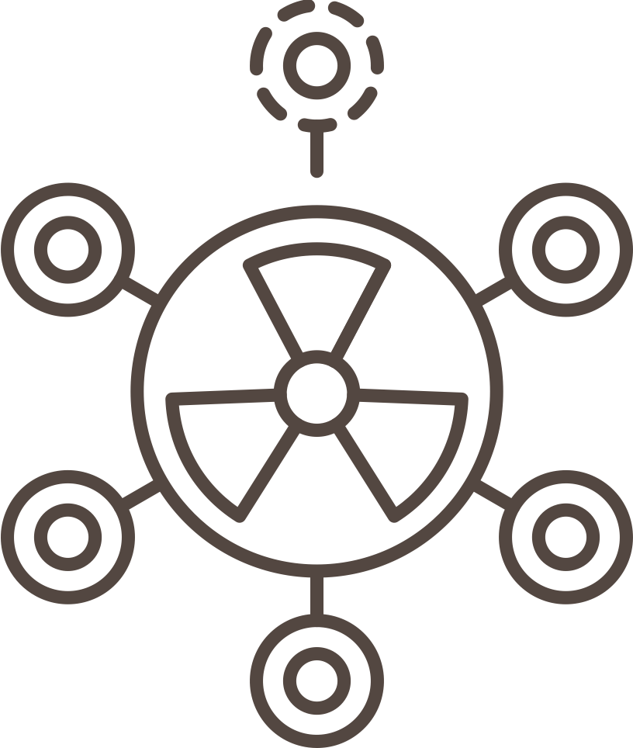
Question 6
This is the only form of radiation that can make other objects radioactive.
Answer:
NEUTRON RADIATION!
Notes:
Instructor Notes:
As you display the questions about various types of radiation from slides 20-29 on the overhead screen, give the teams a specific amount of time (15-20 seconds) to write down their answer to the question without using notes or devices such as laptops, iPads, or cell phones. Teams will hold up their answers when time runs out, and each team that answers the question correctly first will get a card that has the name of that type of radiation (See Reflection Capture Sheet: Radiation Trivia Cards).

Slide 28

Question 7
We only see color because our eyes can detect the reflection of this type of radiation off of objects.
Answer:
VISIBLE
LIGHT!
Notes:
Instructor Notes:
As you display the questions about various types of radiation from slides 20–29 on the overhead screen, give the teams a specific amount of time (15–20 seconds) to write down their answer to the question without using notes or devices such as laptops, iPads, or cell phones. Teams will hold up their answers when time runs out, and each team that answers the question correctly first will get a card that has the name of that type of radiation (See Reflection Capture Sheet: Radiation Trivia Cards).

Slide 29
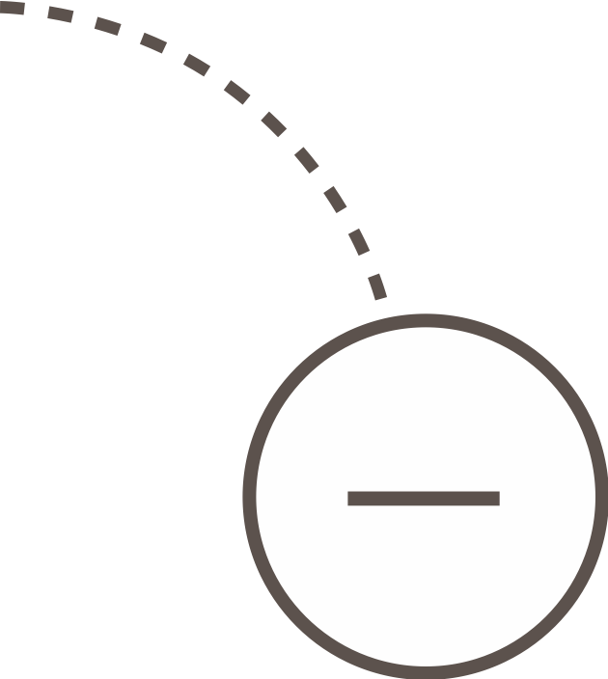
Question 8
When this type of radiation is emitted from a nucleus, a neutron actually turns into a proton.
Answer:
BETA RADIATION!
Notes:
Instructor Notes:
As you display the questions about various types of radiation from slides 20-29 on the overhead screen, give the teams a specific amount of time (15–20 seconds) to write down their answer to the question without using notes or devices such as laptops, iPads, or cell phones. Teams will hold up their answers when time runs out, and each team that answers the question correctly first will get a card that has the name of that type of radiation (See Reflection Capture Sheet: Radiation Trivia Cards).

Slide 30
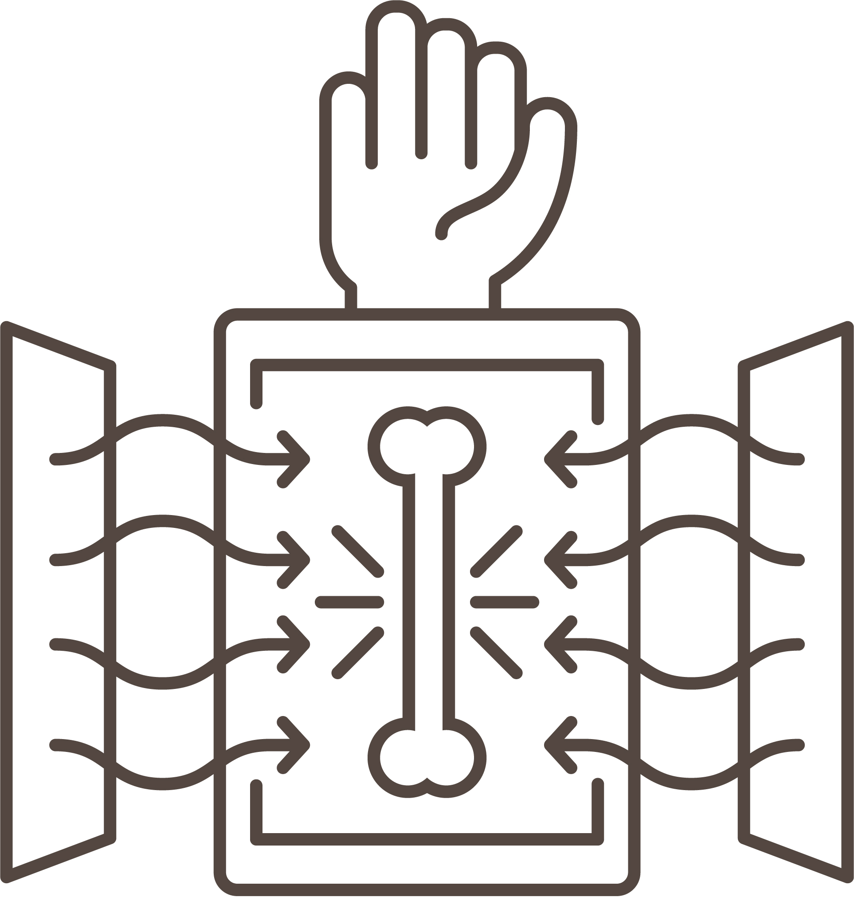
Question 9
This type of radiation got its name because the man who discovered it in 1895 didn’t know what it was!
Answer:
X-RAYS!
Notes:
Instructor Notes:
As you display the questions about various types of radiation from slides 20–29 on the overhead screen, give the teams a specific amount of time (15–20 seconds) to write down their answer to the question without using notes or devices such as laptops, iPads, or cell phones. Teams will hold up their answers when time runs out, and each team that answers the question correctly first will get a card that has the name of that type of radiation (See Reflection Capture Sheet: Radiation Trivia Cards).

Slide 31

Question 10
Some snakes have special sensory pits that are used to “see” this type of radiation and detect warm-blooded prey.
Answer:
INFRARED RADIATION!
Notes:
Instructor Notes:
As you display the questions about various types of radiation from slides 20–29 on the overhead screen, give the teams a specific amount of time (15–20 seconds) to write down their answer to the question without using notes or devices such as laptops, iPads, or cell phones. Teams will hold up their answers when time runs out, and each team that answers the question correctly first will get a card that has the name of that type of radiation (See Reflection Capture Sheet: Radiation Trivia Cards).

Slide 32
Has anyone collected the full spectrum of radiation?
Who will be the winner of the radiation trivia challenge?
The team that has collected the most cards will be declared the winner! Thanks for playing!
Notes:
Instructor Notes: ​
The team that collects the most radiation cards will be declared the winner. If there is a tie, the teams will go head-to-head, and the first team to assemble their cards in order of energy level (from least harmful to most harmful) will be the tie-breaker and will win!

